Slide 1
FLAIR Brain Tumor segmentation with DNN: from U-Net architecture to Vision Transformers
Matteo Liotta
SM3800072
Deep Learning, 2025, UniTS - Final Project

Slide 2
Tumor individuation and segmentation
Cancer was the second leading cause of death in EU in 2021, with a percentage of 21.6 total number of deaths [1].
In 2015 United States estimated the emergence of 23000 new brain related cases in its territory.
Now the most common treatments for the brain tumor is the surgery, but its not always an easy to execute solution [2].
Even if some tumor as meningiomas can be easily segmented, there are other types which could be hardly localized: poorly contrasted, usually diffused, with tentacle-like structures.
Notes:
-i.e. Gliomas and Glioblastomas-

Slide 3
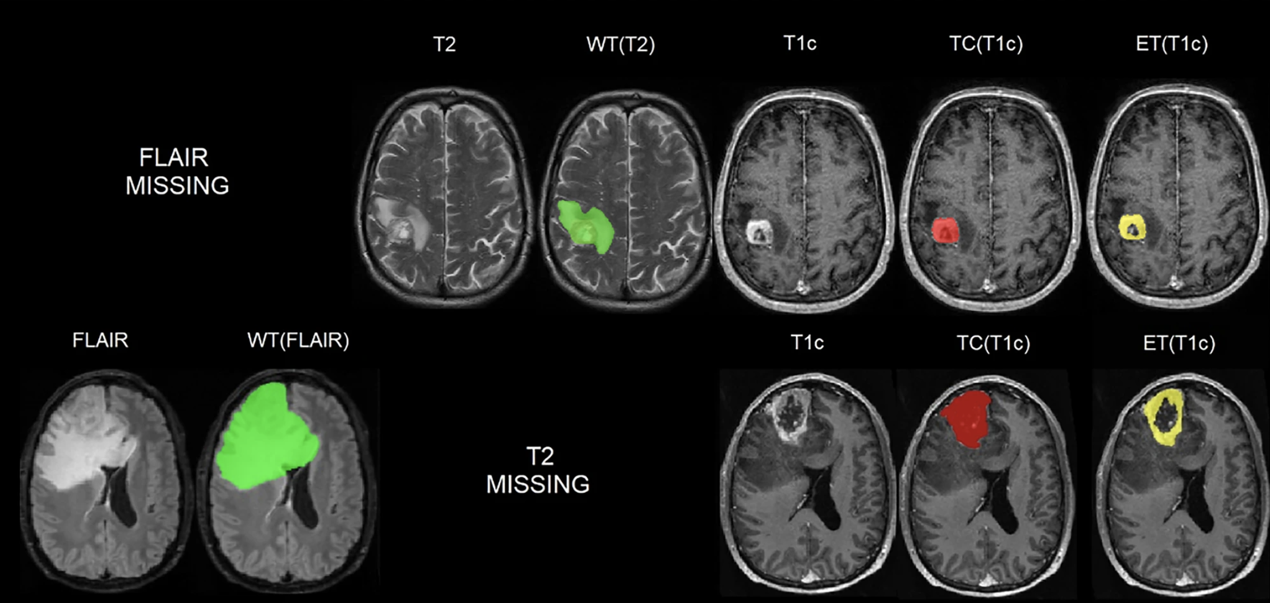
Fig 1. Sample images. Ground truth manual segmentation for a GBM patient with missing FLAIR scan (top row) and one with missing T2w (bottom row). Whole Tumor (WT) in green.

Slide 4
Deep Learning approaches for the segmentation task
The idea is to introduce an exploration in DL models for efficient tumoral region segmentation:
We need input images (dependent on the dataset used)
To produce binary segmentation mask output
Some dataset problem choice emerged:
The image size increase with the quality and image definition
The dataset size increase with the quality of its instances and instances number
The proposed dataset is just some gigabytes heavy, while professional ones are about ~ 100 GB.
Notes:
Input images: dependent on the dataset used: different hospital methodologies for image taking

Slide 5
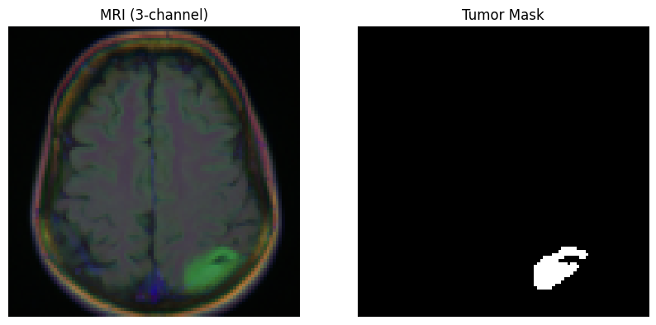
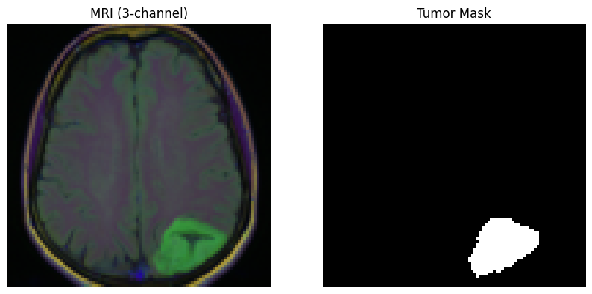
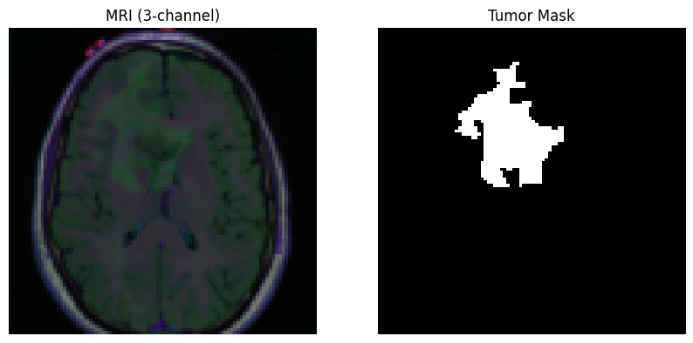
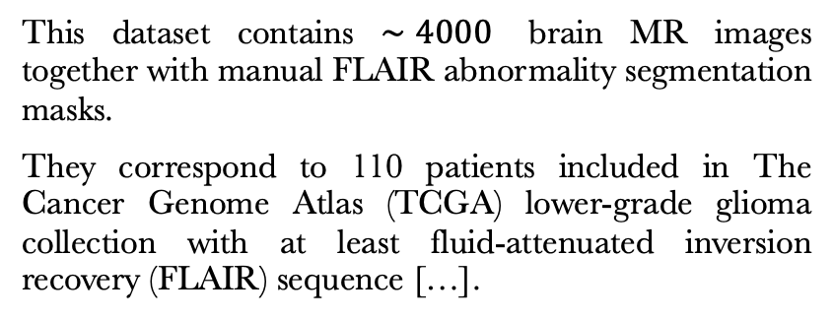
This dataset contains $∼4000$ brain MR images together with manual FLAIR abnormality segmentation masks.
They correspond to 110 patients included in The Cancer Genome Atlas (TCGA) lower-grade glioma collection with at least fluid-attenuated inversion recovery (FLAIR) sequence […].
Fig 2. Dataset [4] Sample images.

Slide 6
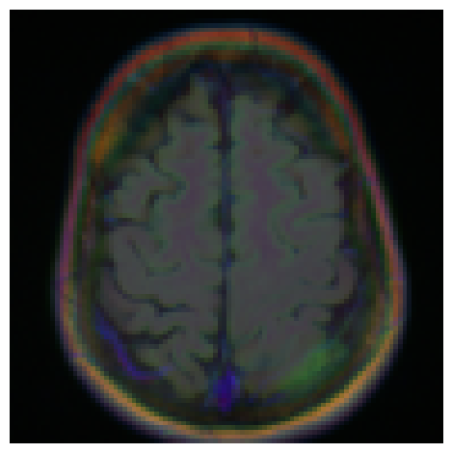
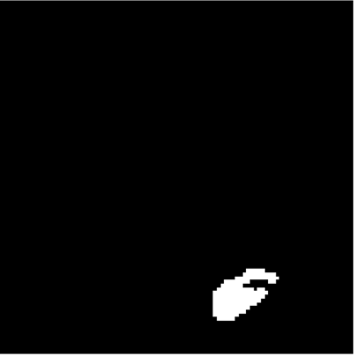
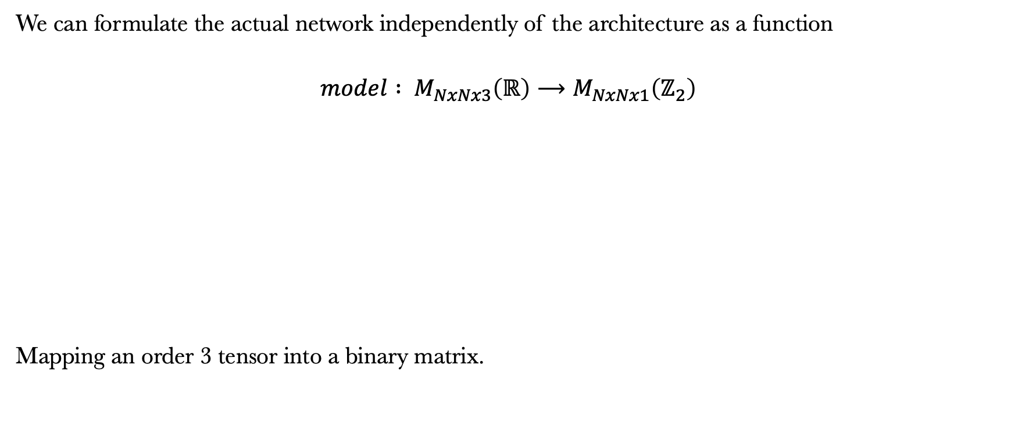
Problem Formalization
We can formulate the actual network independently of the architecture as a function
$$model : M_{NxNx3}\left(ℝ\right)⟶M_{NxNx1}\left(ℤ_{2}\right)$$
Mapping an order 3 tensor into a binary matrix.

Slide 7
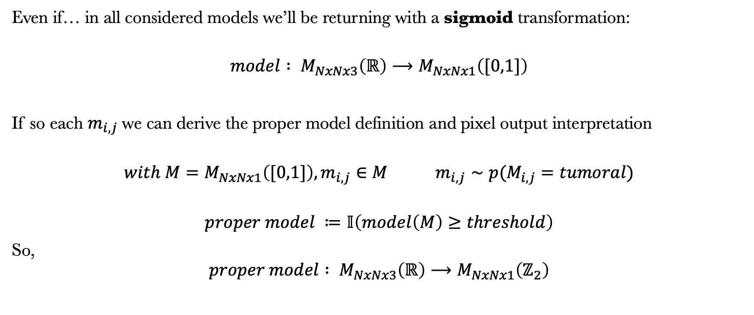
Problem Formalization
Even if… in all considered models we’ll be returning with a sigmoid transformation:
$$model : M_{NxNx3}\left(ℝ\right)⟶M_{NxNx1}\left([0,1]\right)$$
If so each $m_{i,j}$we can derive the proper model definition and pixel output interpretation
$$with M=M_{NxNx1}\left([0,1]\right), m_{i,j}∈M m_{i,j}∼p(M_{i,j}=tumoral)$$
$$proper model ≔𝕀\left(model\left(M\right)≥threshold\right)$$
So,
$$proper model : M_{NxNx3}\left(ℝ\right)⟶M_{NxNx1}\left(ℤ_{2}\right)$$
Notes:
probability value of that pixel belonging to the target class

Slide 8
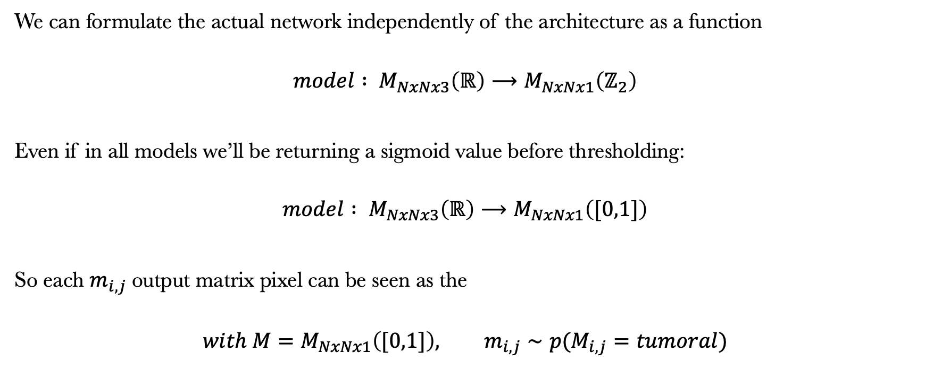
Problem Formalization
We can formulate the actual network independently of the architecture as a function
$$model : M_{NxNx3}\left(ℝ\right)⟶M_{NxNx1}\left(ℤ_{2}\right)$$
Even if in all models we’ll be returning a sigmoid value before thresholding:
$$model : M_{NxNx3}\left(ℝ\right)⟶M_{NxNx1}\left([0,1]\right)$$
So each $m_{i,j}$output matrix pixel can be seen as the
$$with M=M_{NxNx1}\left([0,1]\right), m_{i,j}∼p(M_{i,j}=tumoral)$$
Notes:
probability value of that pixel belonging to the target class

Slide 9
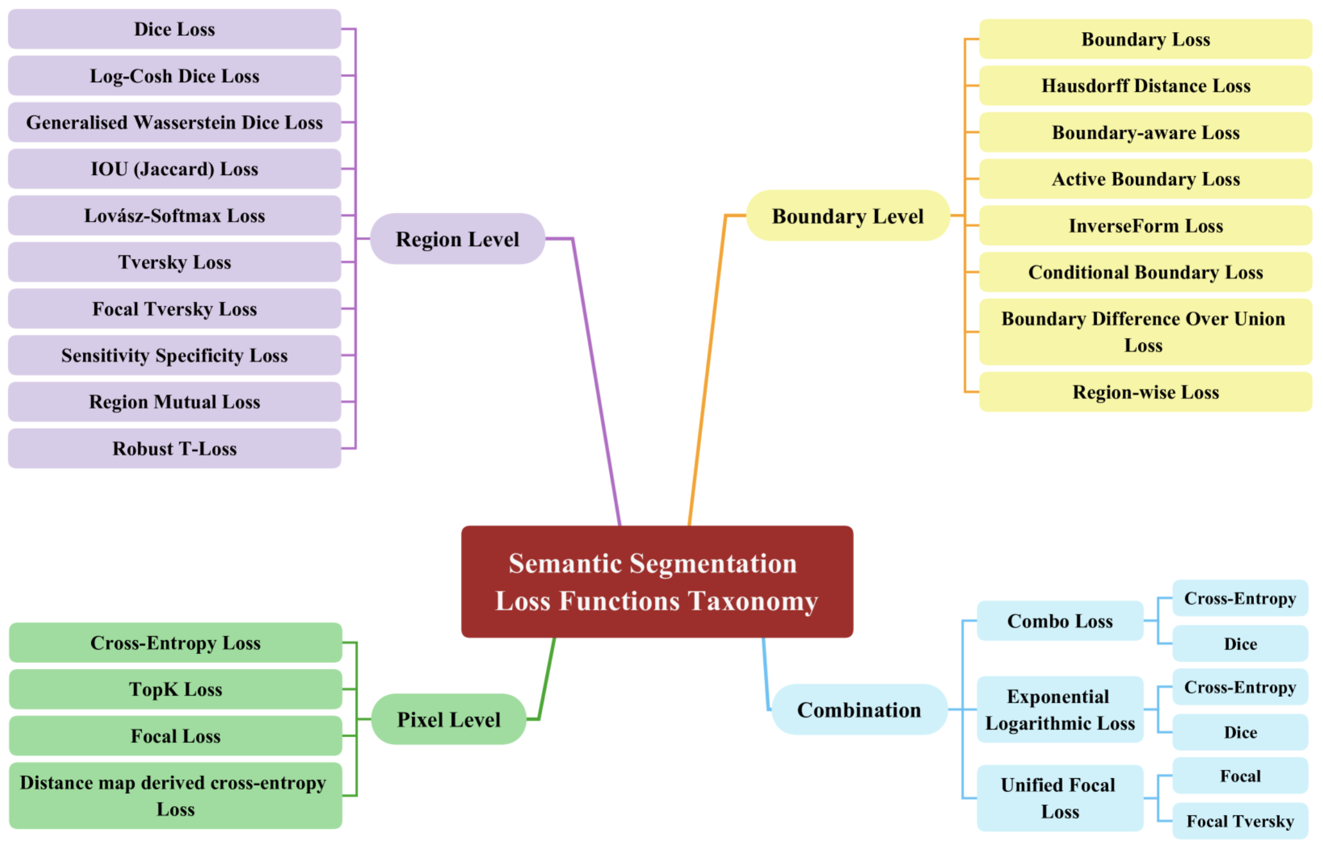
Loss Choice
Optimality depends not only on the right architecture choice but also on an appropriate choice of the loss function.
Different loss functions have been proposed in literature w.r.t. different behaviors of interest.
Fig 2.The loss taxonomy subsections
Notes:
Having defined the model is not enough, since the …

Slide 10
Loss Choice
Pixel Level losses
Considering individual pixels to achieve high accuracy
Region Level losses
Focused on the overall accuracy of the object segmentation itself, by capturing the essence of the object's shape and layout
Boundary Level losses
Specialized in the of object boundaries with sharpen object separate overlapping objects aims
Combination losses
the idea is to harmonize elements from the previous ones and optimize the segmentation performance.
Notes:
Pixel coherence

Slide 11
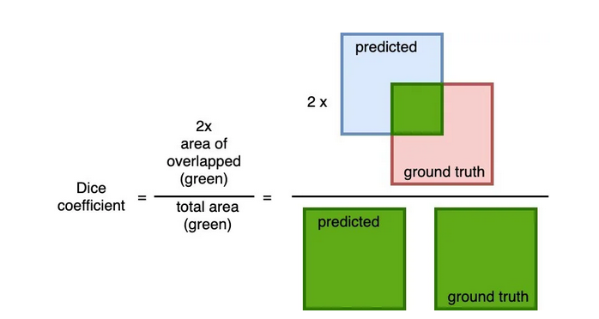
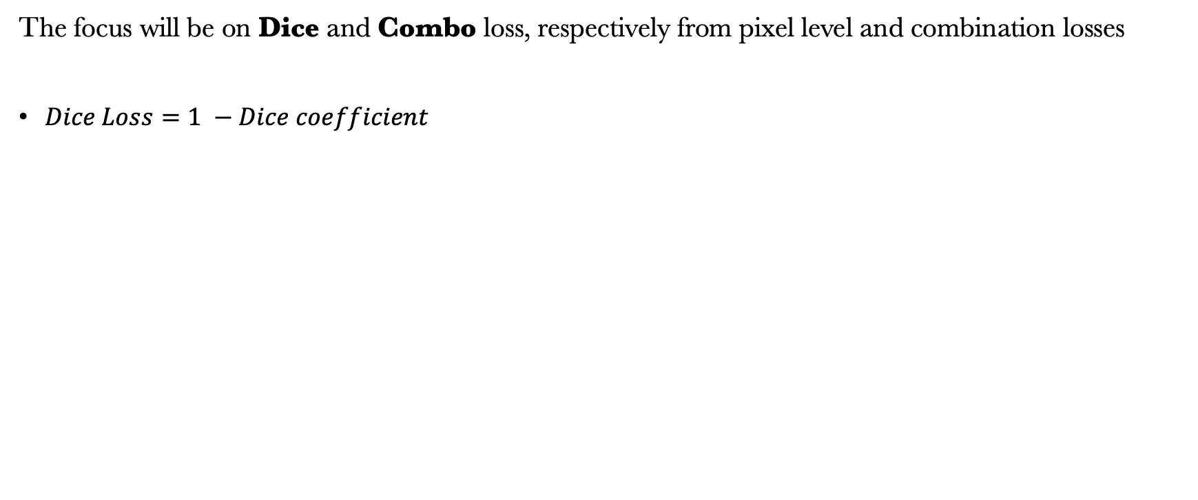
Loss Choice
The focus will be on Dice and Combo loss, respectively from pixel level and combination losses
$Dice Loss=1 −Dice coefficient$

Slide 12
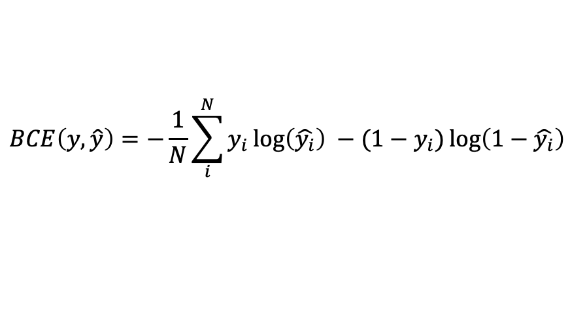
Loss Choice
The focus will be on Dice and Combo loss, respectively from pixel level and combination losses
Combo Loss as weighted average of BCE loss and dice
For $y_{i}, \hat{y}$generic ground truth and predicted output
$$Combo loss\left(y,\hat{y}\right)=α ×BCE+\left(1−α\right) ×DiceLoss$$
$$BCE\left(y,\hat{y}\right)=−\frac{1}{N}\sum_{i}^{N}{y_{i}\log\left(\hat{y_{i}}\right)} −(1−y_{i})\log\left(1−\hat{y_{i}}\right)$$

Slide 13
Models

Slide 14
Models
U-net
SETR (Vision Transformer)
Notes:
0.7 = alpha -> more BCE weight in the loss evalutation
Segmentation TRansformer

Slide 15
Models
Dice Loss U-net
U-net
Combo Loss 0.7 U-net
Combo Loss 0.5 U-net
SETR (Vision Transformer)
Dice Loss SETR
Notes:
0.7 = alpha -> more BCE weight in the loss evalutation

Slide 16
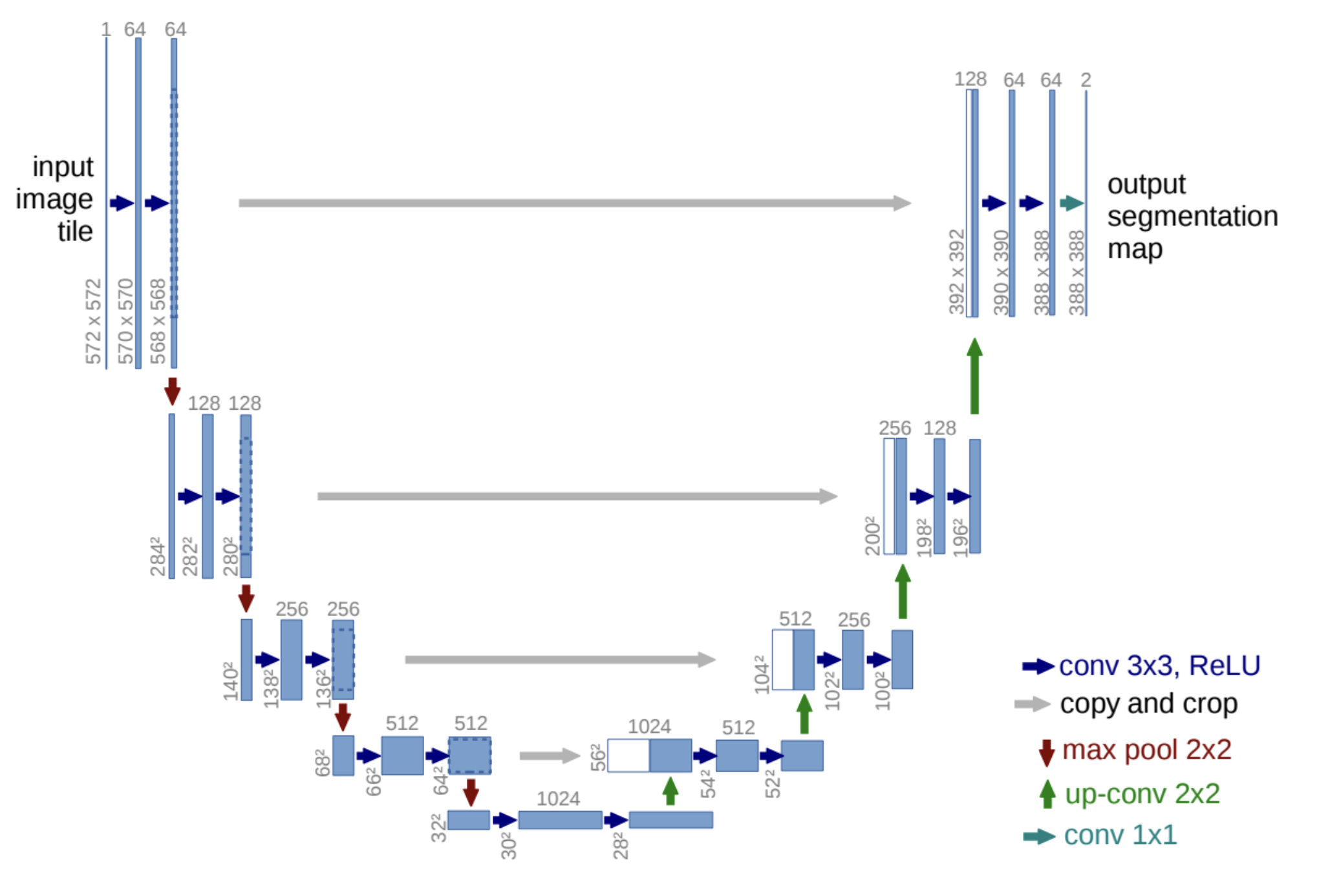
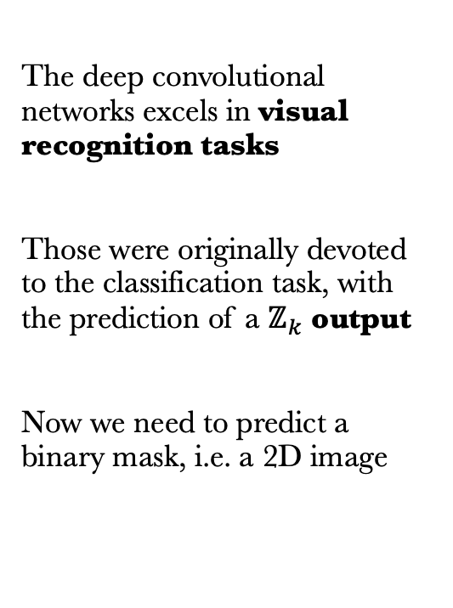
Models: U-net
The deep convolutional networks excels in visual recognition tasks
Those were originally devoted to the classification task, with the prediction of a $ℤ_{k}$ output
Now we need to predict a binary mask, i.e. a 2D image
Fig. 6 U-net architecture [6]

Slide 17
Models: U-net
The network does a convolution for some layers
It reduces and modifies the original input dimensions and channel number
Results of each layer are saved for a later use

Slide 18
Models: U-net
To reconstruct the output mask the model does some deconvolution steps
Notice that the U shape comes due to the reuse of previous layer output: they are now attached to each new layer input

Slide 19
class UNet(nn.Module):
def __init__(self, in_channels=3, out_channels=1):
super().__init__()
# We need to divide the model in different sequential parts, since we do remember
# that the U-net implements the copy-and-crop skip connections.
## ENCODING (down)
self.enc1 = nn.Sequential(
nn.Conv2d(in_channels, 64, 3, padding=1), nn.ReLU(),
nn.Conv2d(64, 64, 3, padding=1), nn.ReLU())
self.pool1 = nn.MaxPool2d(2) self.enc2 = nn.Sequential(
nn.Conv2d(64, 128, 3, padding=1), nn.ReLU(),
nn.Conv2d(128, 128, 3, padding=1), nn.ReLU())
self.pool2 = nn.MaxPool2d(2)
## We reach the end of the U
self.uend = nn.Sequential(nn.Conv2d(128, 256, 3, padding=1), nn.ReLU(), nn.Conv2d(256, 256, 3, padding=1), nn.ReLU())
## DECODING (up)
# It's the opposite of the previous part: remember that the mask
# is needed of the same size of the input image!
self.up2 = nn.ConvTranspose2d(256, 128, 2, stride=2)
self.dec2 = nn.Sequential(
nn.Conv2d(256, 128, 3, padding=1), nn.ReLU(),
nn.Conv2d(128, 128, 3, padding=1), nn.ReLU())
self.up1 = nn.ConvTranspose2d(128, 64, 2, stride=2)
self.dec1 = nn.Sequential(
nn.Conv2d(128, 64, 3, padding=1), nn.ReLU(),
nn.Conv2d(64, 64, 3, padding=1), nn.ReLU())
self.out_conv = nn.Conv2d(64, out_channels, 1)
def forward(self, x):
# The step is to do encoding and pooling up to the end of the U
e1 = self.enc1(x)
p1 = self.pool1(e1)
e2 = self.enc2(p1)
p2 = self.pool2(e2)
b = self.uend(p2)
# Then we need to do the up part, but with the skip connections.
# So, previous inputs are attached to the current ones ()
u2 = self.up2(b)
c2 = torch.cat([e2, u2], dim=1)
d2 = self.dec2(c2)
u1 = self.up1(d2)
c1 = torch.cat([e1, u1], dim=1)
d1 = self.dec1(c1)
out = self.out_conv(d1)
return torch.sigmoid(out)

Slide 20
class UNet(nn.Module):
def __init__(self, in_channels=3, out_channels=1):
super().__init__()
# We need to divide the model in different sequential parts, since we do remember
# that the U-net implements the copy-and-crop skip connections.
## ENCODING (down)
self.enc1 = nn.Sequential(
nn.Conv2d(in_channels, 64, 3, padding=1), nn.ReLU(),
nn.Conv2d(64, 64, 3, padding=1), nn.ReLU())
self.pool1 = nn.MaxPool2d(2) self.enc2 = nn.Sequential(
nn.Conv2d(64, 128, 3, padding=1), nn.ReLU(),
nn.Conv2d(128, 128, 3, padding=1), nn.ReLU())
self.pool2 = nn.MaxPool2d(2)
## We reach the end of the U
self.uend = nn.Sequential(nn.Conv2d(128, 256, 3, padding=1), nn.ReLU(), nn.Conv2d(256, 256, 3, padding=1), nn.ReLU())
## DECODING (up)
# It's the opposite of the previous part: remember that the mask
# is needed of the same size of the input image!
self.up2 = nn.ConvTranspose2d(256, 128, 2, stride=2)
self.dec2 = nn.Sequential(
nn.Conv2d(256, 128, 3, padding=1), nn.ReLU(),
nn.Conv2d(128, 128, 3, padding=1), nn.ReLU())
self.up1 = nn.ConvTranspose2d(128, 64, 2, stride=2)
self.dec1 = nn.Sequential(
nn.Conv2d(128, 64, 3, padding=1), nn.ReLU(),
nn.Conv2d(64, 64, 3, padding=1), nn.ReLU())
self.out_conv = nn.Conv2d(64, out_channels, 1)
Definition of the convolution phase
def forward(self, x):
# The step is to do encoding and pooling up to the end of the U
e1 = self.enc1(x)
p1 = self.pool1(e1)
e2 = self.enc2(p1)
p2 = self.pool2(e2)
b = self.uend(p2)
# Then we need to do the up part, but with the skip connections.
# So, previous inputs are attached to the current ones ()
u2 = self.up2(b)
c2 = torch.cat([e2, u2], dim=1)
d2 = self.dec2(c2)
u1 = self.up1(d2)
c1 = torch.cat([e1, u1], dim=1)
d1 = self.dec1(c1)
out = self.out_conv(d1)
return torch.sigmoid(out)
Sequence of convolution with 64 in 64 channels layers
with ReLU activation and max pooling

Slide 21
class UNet(nn.Module):
def __init__(self, in_channels=3, out_channels=1):
super().__init__()
# We need to divide the model in different sequential parts, since we do remember
# that the U-net implements the copy-and-crop skip connections.
## ENCODING (down)
self.enc1 = nn.Sequential(
nn.Conv2d(in_channels, 64, 3, padding=1), nn.ReLU(),
nn.Conv2d(64, 64, 3, padding=1), nn.ReLU())
self.pool1 = nn.MaxPool2d(2) self.enc2 = nn.Sequential(
nn.Conv2d(64, 128, 3, padding=1), nn.ReLU(),
nn.Conv2d(128, 128, 3, padding=1), nn.ReLU())
self.pool2 = nn.MaxPool2d(2)
## We reach the end of the U
self.uend = nn.Sequential(nn.Conv2d(128, 256, 3, padding=1), nn.ReLU(), nn.Conv2d(256, 256, 3, padding=1), nn.ReLU())
## DECODING (up)
# It's the opposite of the previous part: remember that the mask
# is needed of the same size of the input image!
self.up2 = nn.ConvTranspose2d(256, 128, 2, stride=2)
self.dec2 = nn.Sequential(
nn.Conv2d(256, 128, 3, padding=1), nn.ReLU(),
nn.Conv2d(128, 128, 3, padding=1), nn.ReLU())
self.up1 = nn.ConvTranspose2d(128, 64, 2, stride=2)
self.dec1 = nn.Sequential(
nn.Conv2d(128, 64, 3, padding=1), nn.ReLU(),
nn.Conv2d(64, 64, 3, padding=1), nn.ReLU())
self.out_conv = nn.Conv2d(64, out_channels, 1)
The path is divided into same-channel and doubled + maxpooling steps
def forward(self, x):
# The step is to do encoding and pooling up to the end of the U
e1 = self.enc1(x)
p1 = self.pool1(e1)
e2 = self.enc2(p1)
p2 = self.pool2(e2)
b = self.uend(p2)
# Then we need to do the up part, but with the skip connections.
# So, previous inputs are attached to the current ones ()
u2 = self.up2(b)
c2 = torch.cat([e2, u2], dim=1)
d2 = self.dec2(c2)
u1 = self.up1(d2)
c1 = torch.cat([e1, u1], dim=1)
d1 = self.dec1(c1)
out = self.out_conv(d1)
return torch.sigmoid(out)
Definition of the convolution phase

Slide 22
class UNet(nn.Module):
def __init__(self, in_channels=3, out_channels=1):
super().__init__()
# We need to divide the model in different sequential parts, since we do remember
# that the U-net implements the copy-and-crop skip connections.
## ENCODING (down)
self.enc1 = nn.Sequential(
nn.Conv2d(in_channels, 64, 3, padding=1), nn.ReLU(),
nn.Conv2d(64, 64, 3, padding=1), nn.ReLU())
self.pool1 = nn.MaxPool2d(2) self.enc2 = nn.Sequential(
nn.Conv2d(64, 128, 3, padding=1), nn.ReLU(),
nn.Conv2d(128, 128, 3, padding=1), nn.ReLU())
self.pool2 = nn.MaxPool2d(2)
3 x 3 x 3 kernels applied with same spatial dimension due to padding 1
Definition of the convolution phase
## We reach the end of the U
self.uend = nn.Sequential(nn.Conv2d(128, 256, 3, padding=1), nn.ReLU(), nn.Conv2d(256, 256, 3, padding=1), nn.ReLU())
## DECODING (up)
# It's the opposite of the previous part: remember that the mask
# is needed of the same size of the input image!
self.up2 = nn.ConvTranspose2d(256, 128, 2, stride=2)
self.dec2 = nn.Sequential(
nn.Conv2d(256, 128, 3, padding=1), nn.ReLU(),
nn.Conv2d(128, 128, 3, padding=1), nn.ReLU())
self.up1 = nn.ConvTranspose2d(128, 64, 2, stride=2)
self.dec1 = nn.Sequential(
nn.Conv2d(128, 64, 3, padding=1), nn.ReLU(),
nn.Conv2d(64, 64, 3, padding=1), nn.ReLU())
self.out_conv = nn.Conv2d(64, out_channels, 1)
64 times
def forward(self, x):
# The step is to do encoding and pooling up to the end of the U
e1 = self.enc1(x)
p1 = self.pool1(e1)
e2 = self.enc2(p1)
p2 = self.pool2(e2)
b = self.uend(p2)
# Then we need to do the up part, but with the skip connections.
# So, previous inputs are attached to the current ones ()
u2 = self.up2(b)
c2 = torch.cat([e2, u2], dim=1)
d2 = self.dec2(c2)
u1 = self.up1(d2)
c1 = torch.cat([e1, u1], dim=1)
d1 = self.dec1(c1)
out = self.out_conv(d1)
return torch.sigmoid(out)

Slide 23
class UNet(nn.Module):
def __init__(self, in_channels=3, out_channels=1):
super().__init__()
# We need to divide the model in different sequential parts, since we do remember
# that the U-net implements the copy-and-crop skip connections.
## ENCODING (down)
self.enc1 = nn.Sequential(
nn.Conv2d(in_channels, 64, 3, padding=1), nn.ReLU(),
nn.Conv2d(64, 64, 3, padding=1), nn.ReLU())
self.pool1 = nn.MaxPool2d(2) self.enc2 = nn.Sequential(
nn.Conv2d(64, 128, 3, padding=1), nn.ReLU(),
nn.Conv2d(128, 128, 3, padding=1), nn.ReLU())
self.pool2 = nn.MaxPool2d(2)
At the beginning we obtain 64 output channels
but at each depth level we double the number of channels
Definition of the convolution phase
## We reach the end of the U
self.uend = nn.Sequential(nn.Conv2d(128, 256, 3, padding=1), nn.ReLU(), nn.Conv2d(256, 256, 3, padding=1), nn.ReLU())
## DECODING (up)
# It's the opposite of the previous part: remember that the mask
# is needed of the same size of the input image!
self.up2 = nn.ConvTranspose2d(256, 128, 2, stride=2)
self.dec2 = nn.Sequential(
nn.Conv2d(256, 128, 3, padding=1), nn.ReLU(),
nn.Conv2d(128, 128, 3, padding=1), nn.ReLU())
self.up1 = nn.ConvTranspose2d(128, 64, 2, stride=2)
self.dec1 = nn.Sequential(
nn.Conv2d(128, 64, 3, padding=1), nn.ReLU(),
nn.Conv2d(64, 64, 3, padding=1), nn.ReLU())
self.out_conv = nn.Conv2d(64, out_channels, 1)
Conv2D
+ ReLU
Conv2D
+ ReLU
…
…
def forward(self, x):
# The step is to do encoding and pooling up to the end of the U
e1 = self.enc1(x)
p1 = self.pool1(e1)
e2 = self.enc2(p1)
p2 = self.pool2(e2)
b = self.uend(p2)
# Then we need to do the up part, but with the skip connections.
# So, previous inputs are attached to the current ones ()
u2 = self.up2(b)
c2 = torch.cat([e2, u2], dim=1)
d2 = self.dec2(c2)
u1 = self.up1(d2)
c1 = torch.cat([e1, u1], dim=1)
d1 = self.dec1(c1)
out = self.out_conv(d1)
return torch.sigmoid(out)
1
64
64

Slide 24
class UNet(nn.Module):
def __init__(self, in_channels=3, out_channels=1):
super().__init__()
# We need to divide the model in different sequential parts, since we do remember
# that the U-net implements the copy-and-crop skip connections.
## ENCODING (down)
self.enc1 = nn.Sequential(
nn.Conv2d(in_channels, 64, 3, padding=1), nn.ReLU(),
nn.Conv2d(64, 64, 3, padding=1), nn.ReLU())
self.pool1 = nn.MaxPool2d(2) self.enc2 = nn.Sequential(
nn.Conv2d(64, 128, 3, padding=1), nn.ReLU(),
nn.Conv2d(128, 128, 3, padding=1), nn.ReLU())
self.pool2 = nn.MaxPool2d(2)
## We reach the end of the U
self.uend = nn.Sequential(nn.Conv2d(128, 256, 3, padding=1), nn.ReLU(), nn.Conv2d(256, 256, 3, padding=1), nn.ReLU())
## DECODING (up)
# It's the opposite of the previous part: remember that the mask
# is needed of the same size of the input image!
self.up2 = nn.ConvTranspose2d(256, 128, 2, stride=2)
self.dec2 = nn.Sequential(
nn.Conv2d(256, 128, 3, padding=1), nn.ReLU(),
nn.Conv2d(128, 128, 3, padding=1), nn.ReLU())
self.up1 = nn.ConvTranspose2d(128, 64, 2, stride=2)
self.dec1 = nn.Sequential(
nn.Conv2d(128, 64, 3, padding=1), nn.ReLU(),
nn.Conv2d(64, 64, 3, padding=1), nn.ReLU())
self.out_conv = nn.Conv2d(64, out_channels, 1)
2x
Conv2D
+ ReLU
Relu +
Max-pooling
U-Net Convolution
«depth level»
…
…
…
def forward(self, x):
# The step is to do encoding and pooling up to the end of the U
e1 = self.enc1(x)
p1 = self.pool1(e1)
e2 = self.enc2(p1)
p2 = self.pool2(e2)
b = self.uend(p2)
# Then we need to do the up part, but with the skip connections.
# So, previous inputs are attached to the current ones ()
u2 = self.up2(b)
c2 = torch.cat([e2, u2], dim=1)
d2 = self.dec2(c2)
u1 = self.up1(d2)
c1 = torch.cat([e1, u1], dim=1)
d1 = self.dec1(c1)
out = self.out_conv(d1)
return torch.sigmoid(out)
n
2n
2n

Slide 25
class UNet(nn.Module):
def __init__(self, in_channels=3, out_channels=1):
super().__init__()
# We need to divide the model in different sequential parts, since we do remember
# that the U-net implements the copy-and-crop skip connections.
## ENCODING (down)
self.enc1 = nn.Sequential(
nn.Conv2d(in_channels, 64, 3, padding=1), nn.ReLU(),
nn.Conv2d(64, 64, 3, padding=1), nn.ReLU())
self.pool1 = nn.MaxPool2d(2) self.enc2 = nn.Sequential(
nn.Conv2d(64, 128, 3, padding=1), nn.ReLU(),
nn.Conv2d(128, 128, 3, padding=1), nn.ReLU())
self.pool2 = nn.MaxPool2d(2)
## We reach the end of the U
self.uend = nn.Sequential(nn.Conv2d(128, 256, 3, padding=1), nn.ReLU(), nn.Conv2d(256, 256, 3, padding=1), nn.ReLU())
## DECODING (up)
# It's the opposite of the previous part: remember that the mask
# is needed of the same size of the input image!
self.up2 = nn.ConvTranspose2d(256, 128, 2, stride=2)
self.dec2 = nn.Sequential(
nn.Conv2d(256, 128, 3, padding=1), nn.ReLU(),
nn.Conv2d(128, 128, 3, padding=1), nn.ReLU())
self.up1 = nn.ConvTranspose2d(128, 64, 2, stride=2)
self.dec1 = nn.Sequential(
nn.Conv2d(128, 64, 3, padding=1), nn.ReLU(),
nn.Conv2d(64, 64, 3, padding=1), nn.ReLU())
self.out_conv = nn.Conv2d(64, out_channels, 1)
2x
Conv2D
+ ReLU
Relu +
Max-pooling
U-Net Convolution
«depth level»
…
…
…
def forward(self, x):
# The step is to do encoding and pooling up to the end of the U
e1 = self.enc1(x)
p1 = self.pool1(e1)
e2 = self.enc2(p1)
p2 = self.pool2(e2)
b = self.uend(p2)
# Then we need to do the up part, but with the skip connections.
# So, previous inputs are attached to the current ones ()
u2 = self.up2(b)
c2 = torch.cat([e2, u2], dim=1)
d2 = self.dec2(c2)
u1 = self.up1(d2)
c1 = torch.cat([e1, u1], dim=1)
d1 = self.dec1(c1)
out = self.out_conv(d1)
return torch.sigmoid(out)
n
2n
2n
Remember that this will be pre-appended to the same level first deconvolution input

Slide 26
class UNet(nn.Module):
def __init__(self, in_channels=3, out_channels=1):
super().__init__()
# We need to divide the model in different sequential parts, since we do remember
# that the U-net implements the copy-and-crop skip connections.
## ENCODING (down)
self.enc1 = nn.Sequential(
nn.Conv2d(in_channels, 64, 3, padding=1), nn.ReLU(),
nn.Conv2d(64, 64, 3, padding=1), nn.ReLU())
self.pool1 = nn.MaxPool2d(2) self.enc2 = nn.Sequential(
nn.Conv2d(64, 128, 3, padding=1), nn.ReLU(),
nn.Conv2d(128, 128, 3, padding=1), nn.ReLU())
self.pool2 = nn.MaxPool2d(2)
## We reach the end of the U
self.uend = nn.Sequential(nn.Conv2d(128, 256, 3, padding=1), nn.ReLU(), nn.Conv2d(256, 256, 3, padding=1), nn.ReLU())
## DECODING (up)
# It's the opposite of the previous part: remember that the mask
# is needed of the same size of the input image!
self.up2 = nn.ConvTranspose2d(256, 128, 2, stride=2)
self.dec2 = nn.Sequential(
nn.Conv2d(256, 128, 3, padding=1), nn.ReLU(),
nn.Conv2d(128, 128, 3, padding=1), nn.ReLU())
self.up1 = nn.ConvTranspose2d(128, 64, 2, stride=2)
self.dec1 = nn.Sequential(
nn.Conv2d(128, 64, 3, padding=1), nn.ReLU(),
nn.Conv2d(64, 64, 3, padding=1), nn.ReLU())
self.out_conv = nn.Conv2d(64, out_channels, 1)
def forward(self, x):
# The step is to do encoding and pooling up to the end of the U
e1 = self.enc1(x)
p1 = self.pool1(e1)
e2 = self.enc2(p1)
p2 = self.pool2(e2)
b = self.uend(p2)
# Then we need to do the up part, but with the skip connections.
# So, previous inputs are attached to the current ones ()
u2 = self.up2(b)
c2 = torch.cat([e2, u2], dim=1)
d2 = self.dec2(c2)
u1 = self.up1(d2)
c1 = torch.cat([e1, u1], dim=1)
d1 = self.dec1(c1)
out = self.out_conv(d1)
return torch.sigmoid(out)

Slide 27
class UNet(nn.Module):
def __init__(self, in_channels=3, out_channels=1):
super().__init__()
# We need to divide the model in different sequential parts, since we do remember
# that the U-net implements the copy-and-crop skip connections.
## ENCODING (down)
self.enc1 = nn.Sequential(
nn.Conv2d(in_channels, 64, 3, padding=1), nn.ReLU(),
nn.Conv2d(64, 64, 3, padding=1), nn.ReLU())
self.pool1 = nn.MaxPool2d(2) self.enc2 = nn.Sequential(
nn.Conv2d(64, 128, 3, padding=1), nn.ReLU(),
nn.Conv2d(128, 128, 3, padding=1), nn.ReLU())
self.pool2 = nn.MaxPool2d(2)
## We reach the end of the U
self.uend = nn.Sequential(nn.Conv2d(128, 256, 3, padding=1), nn.ReLU(), nn.Conv2d(256, 256, 3, padding=1), nn.ReLU())
## DECODING (up)
# It's the opposite of the previous part: remember that the mask
# is needed of the same size of the input image!
self.up2 = nn.ConvTranspose2d(256, 128, 2, stride=2)
self.dec2 = nn.Sequential(
nn.Conv2d(256, 128, 3, padding=1), nn.ReLU(),
nn.Conv2d(128, 128, 3, padding=1), nn.ReLU())
self.up1 = nn.ConvTranspose2d(128, 64, 2, stride=2)
self.dec1 = nn.Sequential(
nn.Conv2d(128, 64, 3, padding=1), nn.ReLU(),
nn.Conv2d(64, 64, 3, padding=1), nn.ReLU())
self.out_conv = nn.Conv2d(64, out_channels, 1)
def forward(self, x):
# The step is to do encoding and pooling up to the end of the U
e1 = self.enc1(x)
p1 = self.pool1(e1)
e2 = self.enc2(p1)
p2 = self.pool2(e2)
b = self.uend(p2)
# Then we need to do the up part, but with the skip connections.
# So, previous inputs are attached to the current ones ()
u2 = self.up2(b)
c2 = torch.cat([e2, u2], dim=1)
d2 = self.dec2(c2)
u1 = self.up1(d2)
c1 = torch.cat([e1, u1], dim=1)
d1 = self.dec1(c1)
out = self.out_conv(d1)
return torch.sigmoid(out)
Definition of the bottleneck
Sequence of convolution layers and Relu activations

Slide 28
class UNet(nn.Module):
def __init__(self, in_channels=3, out_channels=1):
super().__init__()
# We need to divide the model in different sequential parts, since we do remember
# that the U-net implements the copy-and-crop skip connections.
## ENCODING (down)
self.enc1 = nn.Sequential(
nn.Conv2d(in_channels, 64, 3, padding=1), nn.ReLU(),
nn.Conv2d(64, 64, 3, padding=1), nn.ReLU())
self.pool1 = nn.MaxPool2d(2) self.enc2 = nn.Sequential(
nn.Conv2d(64, 128, 3, padding=1), nn.ReLU(),
nn.Conv2d(128, 128, 3, padding=1), nn.ReLU())
self.pool2 = nn.MaxPool2d(2)
## We reach the end of the U
self.uend = nn.Sequential(nn.Conv2d(128, 256, 3, padding=1), nn.ReLU(), nn.Conv2d(256, 256, 3, padding=1), nn.ReLU())
## DECODING (up)
# It's the opposite of the previous part: remember that the mask
# is needed of the same size of the input image!
self.up2 = nn.ConvTranspose2d(256, 128, 2, stride=2)
self.dec2 = nn.Sequential(
nn.Conv2d(256, 128, 3, padding=1), nn.ReLU(),
nn.Conv2d(128, 128, 3, padding=1), nn.ReLU())
self.up1 = nn.ConvTranspose2d(128, 64, 2, stride=2)
self.dec1 = nn.Sequential(
nn.Conv2d(128, 64, 3, padding=1), nn.ReLU(),
nn.Conv2d(64, 64, 3, padding=1), nn.ReLU())
self.out_conv = nn.Conv2d(64, out_channels, 1)
def forward(self, x):
# The step is to do encoding and pooling up to the end of the U
e1 = self.enc1(x)
p1 = self.pool1(e1)
e2 = self.enc2(p1)
p2 = self.pool2(e2)
b = self.uend(p2)
# Then we need to do the up part, but with the skip connections.
# So, previous inputs are attached to the current ones ()
u2 = self.up2(b)
c2 = torch.cat([e2, u2], dim=1)
d2 = self.dec2(c2)
u1 = self.up1(d2)
c1 = torch.cat([e1, u1], dim=1)
d1 = self.dec1(c1)
out = self.out_conv(d1)
return torch.sigmoid(out)

Slide 29
class UNet(nn.Module):
def __init__(self, in_channels=3, out_channels=1):
super().__init__()
# We need to divide the model in different sequential parts, since we do remember
# that the U-net implements the copy-and-crop skip connections.
## ENCODING (down)
self.enc1 = nn.Sequential(
nn.Conv2d(in_channels, 64, 3, padding=1), nn.ReLU(),
nn.Conv2d(64, 64, 3, padding=1), nn.ReLU())
self.pool1 = nn.MaxPool2d(2) self.enc2 = nn.Sequential(
nn.Conv2d(64, 128, 3, padding=1), nn.ReLU(),
nn.Conv2d(128, 128, 3, padding=1), nn.ReLU())
self.pool2 = nn.MaxPool2d(2)
Definition of the deconvolution phase
Analogue to the convolution phase with doubled in-channels, because…
## We reach the end of the U
self.uend = nn.Sequential(nn.Conv2d(128, 256, 3, padding=1), nn.ReLU(), nn.Conv2d(256, 256, 3, padding=1), nn.ReLU())
## DECODING (up)
# It's the opposite of the previous part: remember that the mask
# is needed of the same size of the input image!
self.up2 = nn.ConvTranspose2d(256, 128, 2, stride=2)
self.dec2 = nn.Sequential(
nn.Conv2d(256, 128, 3, padding=1), nn.ReLU(),
nn.Conv2d(128, 128, 3, padding=1), nn.ReLU())
self.up1 = nn.ConvTranspose2d(128, 64, 2, stride=2)
self.dec1 = nn.Sequential(
nn.Conv2d(128, 64, 3, padding=1), nn.ReLU(),
nn.Conv2d(64, 64, 3, padding=1), nn.ReLU())
self.out_conv = nn.Conv2d(64, out_channels, 1)
def forward(self, x):
# The step is to do encoding and pooling up to the end of the U
e1 = self.enc1(x)
p1 = self.pool1(e1)
e2 = self.enc2(p1)
p2 = self.pool2(e2)
b = self.uend(p2)
# Then we need to do the up part, but with the skip connections.
# So, previous inputs are attached to the current ones ()
u2 = self.up2(b)
c2 = torch.cat([e2, u2], dim=1)
d2 = self.dec2(c2)
u1 = self.up1(d2)
c1 = torch.cat([e1, u1], dim=1)
d1 = self.dec1(c1)
out = self.out_conv(d1)
return torch.sigmoid(out)

Slide 30
class UNet(nn.Module):
def __init__(self, in_channels=3, out_channels=1):
super().__init__()
# We need to divide the model in different sequential parts, since we do remember
# that the U-net implements the copy-and-crop skip connections.
## ENCODING (down)
self.enc1 = nn.Sequential(
nn.Conv2d(in_channels, 64, 3, padding=1), nn.ReLU(),
nn.Conv2d(64, 64, 3, padding=1), nn.ReLU())
self.pool1 = nn.MaxPool2d(2) self.enc2 = nn.Sequential(
nn.Conv2d(64, 128, 3, padding=1), nn.ReLU(),
nn.Conv2d(128, 128, 3, padding=1), nn.ReLU())
self.pool2 = nn.MaxPool2d(2)
Definition of the deconvolution phase
…the previous convolution output will be pre-appended
## We reach the end of the U
self.uend = nn.Sequential(nn.Conv2d(128, 256, 3, padding=1), nn.ReLU(), nn.Conv2d(256, 256, 3, padding=1), nn.ReLU())
2x
Conv2D
+ ReLU
Relu +
Max-pooling
U-Net Convolution
«depth level»
…
…
…
def forward(self, x):
# The step is to do encoding and pooling up to the end of the U
e1 = self.enc1(x)
p1 = self.pool1(e1)
e2 = self.enc2(p1)
p2 = self.pool2(e2)
b = self.uend(p2)
# Then we need to do the up part, but with the skip connections.
# So, previous inputs are attached to the current ones ()
u2 = self.up2(b)
c2 = torch.cat([e2, u2], dim=1)
d2 = self.dec2(c2)
u1 = self.up1(d2)
c1 = torch.cat([e1, u1], dim=1)
d1 = self.dec1(c1)
out = self.out_conv(d1)
return torch.sigmoid(out)
n
2n
2n

Slide 31
class UNet(nn.Module):
def __init__(self, in_channels=3, out_channels=1):
super().__init__()
# We need to divide the model in different sequential parts, since we do remember
# that the U-net implements the copy-and-crop skip connections.
## ENCODING (down)
self.enc1 = nn.Sequential(
nn.Conv2d(in_channels, 64, 3, padding=1), nn.ReLU(),
nn.Conv2d(64, 64, 3, padding=1), nn.ReLU())
self.pool1 = nn.MaxPool2d(2) self.enc2 = nn.Sequential(
nn.Conv2d(64, 128, 3, padding=1), nn.ReLU(),
nn.Conv2d(128, 128, 3, padding=1), nn.ReLU())
self.pool2 = nn.MaxPool2d(2)
Definition of the deconvolution phase
The up deconvolution 2x2 with the pre-appending makes the next depth
input of the same shape of the final output of the previous depth
## We reach the end of the U
self.uend = nn.Sequential(nn.Conv2d(128, 256, 3, padding=1), nn.ReLU(), nn.Conv2d(256, 256, 3, padding=1), nn.ReLU())
…
def forward(self, x):
# The step is to do encoding and pooling up to the end of the U
e1 = self.enc1(x)
p1 = self.pool1(e1)
e2 = self.enc2(p1)
p2 = self.pool2(e2)
b = self.uend(p2)
# Then we need to do the up part, but with the skip connections.
# So, previous inputs are attached to the current ones ()
u2 = self.up2(b)
c2 = torch.cat([e2, u2], dim=1)
d2 = self.dec2(c2)
u1 = self.up1(d2)
c1 = torch.cat([e1, u1], dim=1)
d1 = self.dec1(c1)
out = self.out_conv(d1)
return torch.sigmoid(out)
…

Slide 32
class UNet(nn.Module):
def __init__(self, in_channels=3, out_channels=1):
super().__init__()
# We need to divide the model in different sequential parts, since we do remember
# that the U-net implements the copy-and-crop skip connections.
## ENCODING (down)
self.enc1 = nn.Sequential(
nn.Conv2d(in_channels, 64, 3, padding=1), nn.ReLU(),
nn.Conv2d(64, 64, 3, padding=1), nn.ReLU())
self.pool1 = nn.MaxPool2d(2) self.enc2 = nn.Sequential(
nn.Conv2d(64, 128, 3, padding=1), nn.ReLU(),
nn.Conv2d(128, 128, 3, padding=1), nn.ReLU())
self.pool2 = nn.MaxPool2d(2)
## We reach the end of the U
self.uend = nn.Sequential(nn.Conv2d(128, 256, 3, padding=1), nn.ReLU(), nn.Conv2d(256, 256, 3, padding=1), nn.ReLU())
## DECODING (up)
# It's the opposite of the previous part: remember that the mask
# is needed of the same size of the input image!
self.up2 = nn.ConvTranspose2d(256, 128, 2, stride=2)
self.dec2 = nn.Sequential(
nn.Conv2d(256, 128, 3, padding=1), nn.ReLU(),
nn.Conv2d(128, 128, 3, padding=1), nn.ReLU())
self.up1 = nn.ConvTranspose2d(128, 64, 2, stride=2)
self.dec1 = nn.Sequential(
nn.Conv2d(128, 64, 3, padding=1), nn.ReLU(),
nn.Conv2d(64, 64, 3, padding=1), nn.ReLU())
self.out_conv = nn.Conv2d(64, out_channels, 1)
def forward(self, x):
# The step is to do encoding and pooling up to the end of the U
e1 = self.enc1(x)
p1 = self.pool1(e1)
e2 = self.enc2(p1)
p2 = self.pool2(e2)
b = self.uend(p2)
# Then we need to do the up part, but with the skip connections.
# So, previous inputs are attached to the current ones ()
u2 = self.up2(b)
c2 = torch.cat([e2, u2], dim=1)
d2 = self.dec2(c2)
u1 = self.up1(d2)
c1 = torch.cat([e1, u1], dim=1)
d1 = self.dec1(c1)
out = self.out_conv(d1)
return torch.sigmoid(out)

Slide 33
class UNet(nn.Module):
def __init__(self, in_channels=3, out_channels=1):
super().__init__()
# We need to divide the model in different sequential parts, since we do remember
# that the U-net implements the copy-and-crop skip connections.
## ENCODING (down)
self.enc1 = nn.Sequential(
nn.Conv2d(in_channels, 64, 3, padding=1), nn.ReLU(),
nn.Conv2d(64, 64, 3, padding=1), nn.ReLU())
self.pool1 = nn.MaxPool2d(2) self.enc2 = nn.Sequential(
nn.Conv2d(64, 128, 3, padding=1), nn.ReLU(),
nn.Conv2d(128, 128, 3, padding=1), nn.ReLU())
self.pool2 = nn.MaxPool2d(2)
Forward of the model
Model behavior with previous definitions and sigmoid return.
Here we can see the pre-appending in the deconvolution phase
## We reach the end of the U
self.uend = nn.Sequential(nn.Conv2d(128, 256, 3, padding=1), nn.ReLU(), nn.Conv2d(256, 256, 3, padding=1), nn.ReLU())
## DECODING (up)
# It's the opposite of the previous part: remember that the mask
# is needed of the same size of the input image!
self.up2 = nn.ConvTranspose2d(256, 128, 2, stride=2)
self.dec2 = nn.Sequential(
nn.Conv2d(256, 128, 3, padding=1), nn.ReLU(),
nn.Conv2d(128, 128, 3, padding=1), nn.ReLU())
self.up1 = nn.ConvTranspose2d(128, 64, 2, stride=2)
self.dec1 = nn.Sequential(
nn.Conv2d(128, 64, 3, padding=1), nn.ReLU(),
nn.Conv2d(64, 64, 3, padding=1), nn.ReLU())
self.out_conv = nn.Conv2d(64, out_channels, 1)
def forward(self, x):
# The step is to do encoding and pooling up to the end of the U
e1 = self.enc1(x)
p1 = self.pool1(e1)
e2 = self.enc2(p1)
p2 = self.pool2(e2)
b = self.uend(p2)
# Then we need to do the up part, but with the skip connections.
# So, previous inputs are attached to the current ones ()
u2 = self.up2(b)
c2 = torch.cat([e2, u2], dim=1)
d2 = self.dec2(c2)
u1 = self.up1(d2)
c1 = torch.cat([e1, u1], dim=1)
d1 = self.dec1(c1)
out = self.out_conv(d1)
return torch.sigmoid(out)

Slide 34
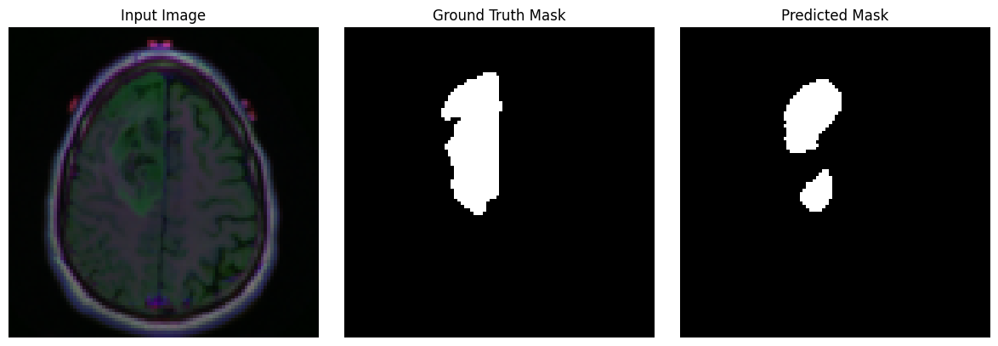
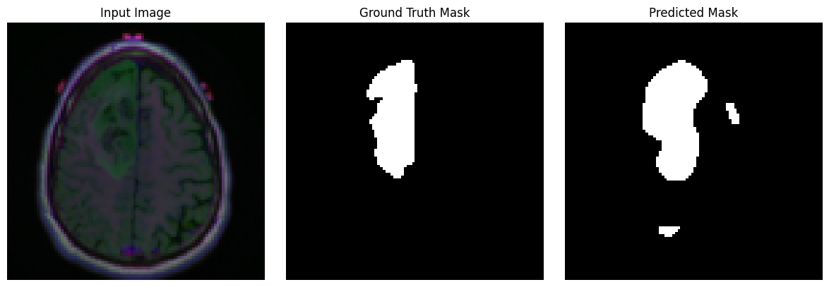
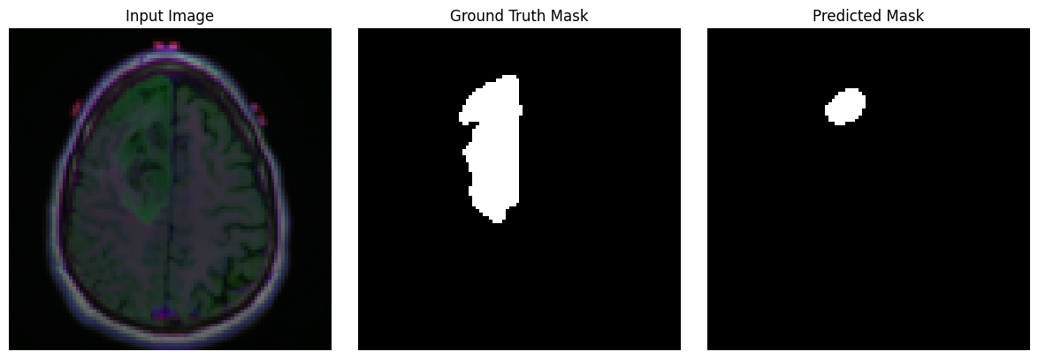
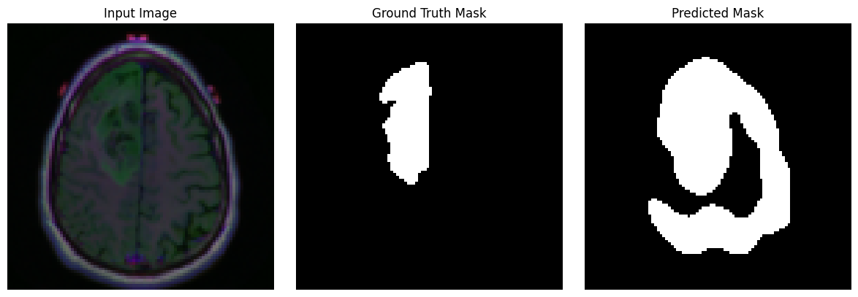
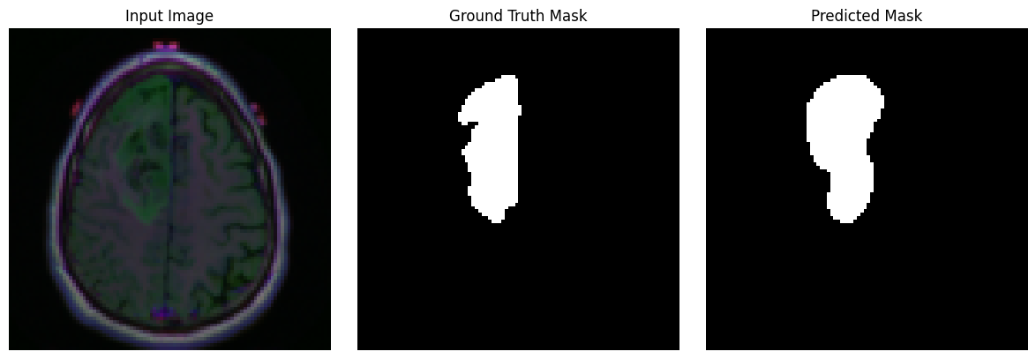
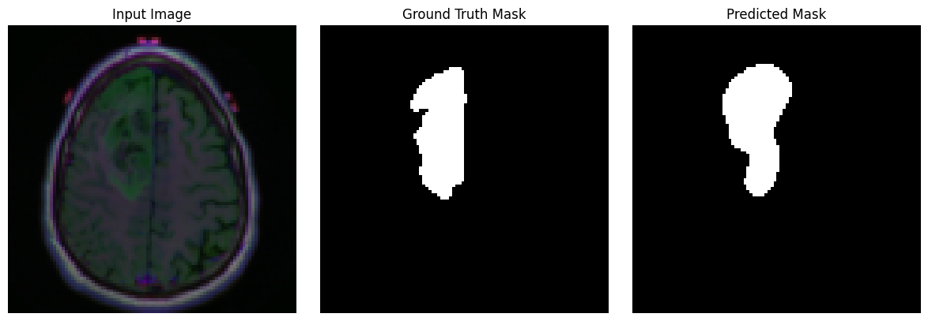
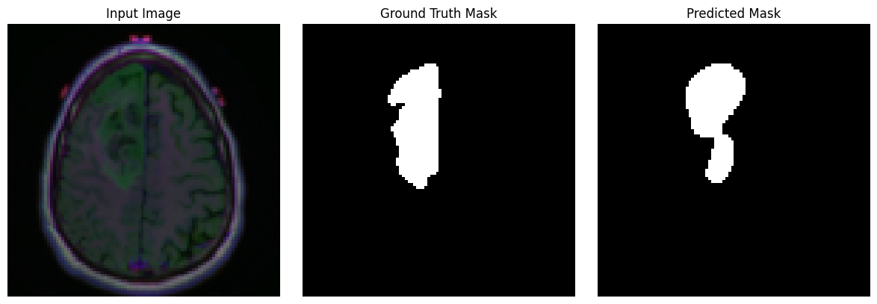
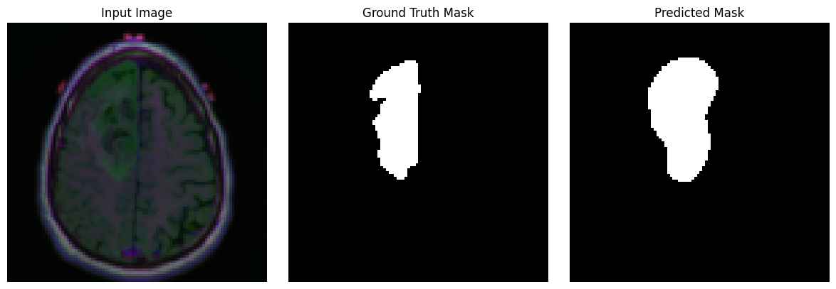

U-Net Dice loss

Slide 35
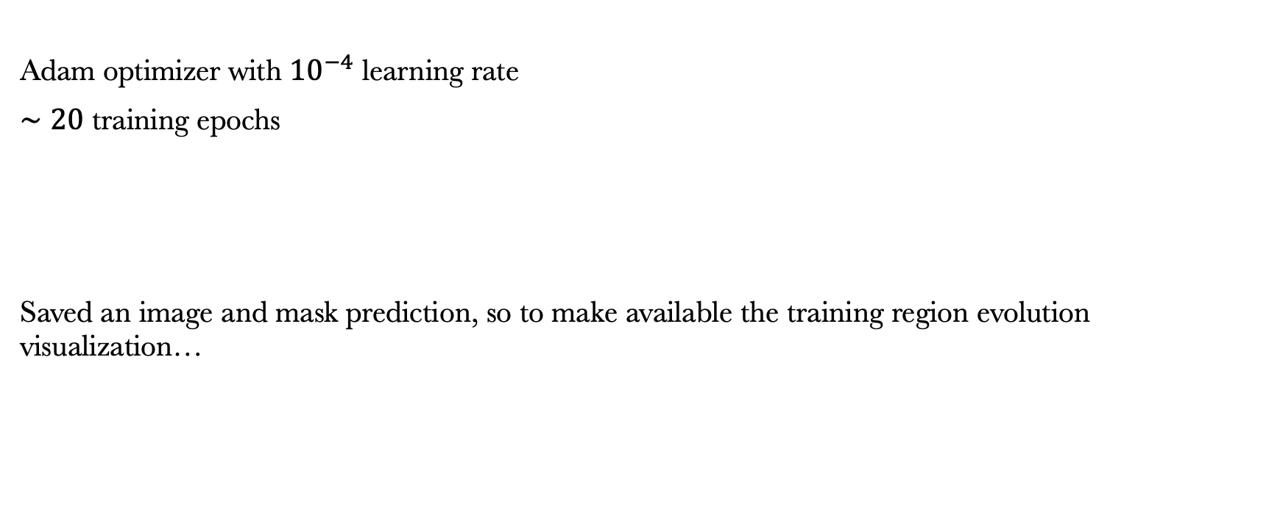
U-Net with Dice Loss Training Informations
Adam optimizer with ${10}^{−4}$ learning rate
$∼20$ training epochs
Saved an image and mask prediction, so to make available the training region evolution visualization…

Slide 36
U-Net with Dice Loss Visualizing the training region evolution

Slide 37
U-Net with Dice Loss Visualizing the training region evolution

Slide 38
U-Net with Dice Loss Visualizing the training region evolution

Slide 39
U-Net with Dice Loss Visualizing the training region evolution

Slide 40
U-Net with Dice Loss Visualizing the training region evolution

Slide 41
U-Net with Dice Loss Visualizing the training region evolution

Slide 42
U-Net with Dice Loss Visualizing the training region evolution

Slide 43
U-Net with Dice Loss Visualizing the training region evolution

Slide 44
U-Net with Dice Loss Visualizing the training region evolution

Slide 45
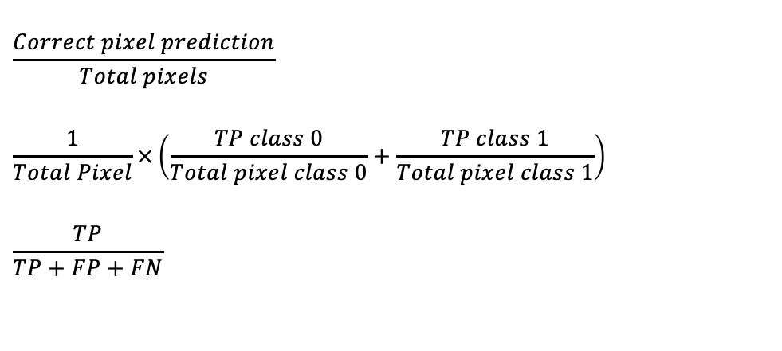
U-Net with Dice Loss Accuracy results on the test set
Since we’ll consider different losses, let’s introduce different metrics in order to compare results
1. Pixel Accuracy
2. Mean Accuracy
3. IoU
$$\frac{Correct pixel prediction}{Total pixels}$$
$$\frac{1}{Total Pixel}×\left(\frac{TP class 0}{Total pixel class 0}+\frac{TP class 1}{Total pixel class 1}\right)$$
$$\frac{TP}{TP+FP+FN}$$
Notes:
IoU intersection over union

Slide 46
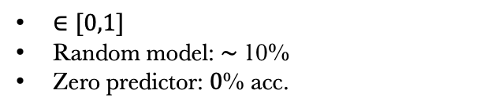
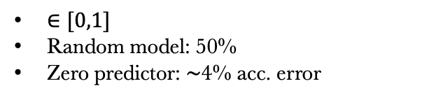
U-Net with Dice Loss Accuracy results on the test set
1. Pixel Accuracy
2. Mean Accuracy
3. IoU
$$\frac{Correct pixel prediction}{Total pixels}$$
$$\frac{1}{Total Pixel}×\left(\frac{TP class 0}{Total pixel class 0}+\frac{TP class 1}{Total pixel class 1}\right)$$
$$\frac{TP}{TP+FP+FN}$$
$∈[0,1]$
Random model: 50%
Zero predictor: $∼$4% acc. error
$∈[0,1]$
Random model: $∼$10%
Zero predictor: $0$% acc.
Notes:
IoU intersection over union
IoU intersection over union
60% of empty mask
Zero prediction possible over 10% of the other 40%
10% perché guardi all’expected pesato

Slide 47
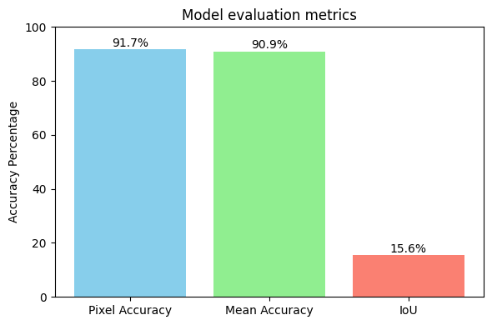
U-Net with Dice Loss Accuracy results on the test set
1. Pixel Accuracy
2. Mean Accuracy
3. IoU
Notes:
IoU intersection over union
IoU intersection over union
60% of empty mask
Zero prediction possible over 10% of the other 40%
10% perché guardi all’expected pesato

Slide 48
U-Net with 0.7 CE Combo Loss Training Informations
Adam optimizer with ${10}^{−4}$ learning rate
$∼20$ training epochs
Saved an image and mask prediction, so to make available the training region evolution visualization…

Slide 49
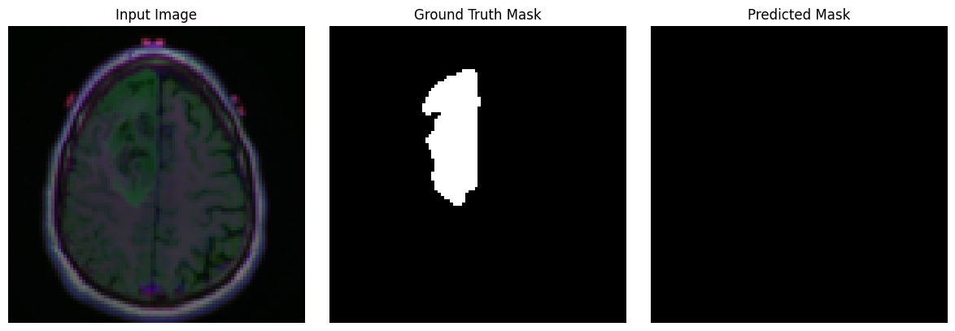
U-Net with 0.7 CE Combo Loss visualizing the training region evolution

Slide 50
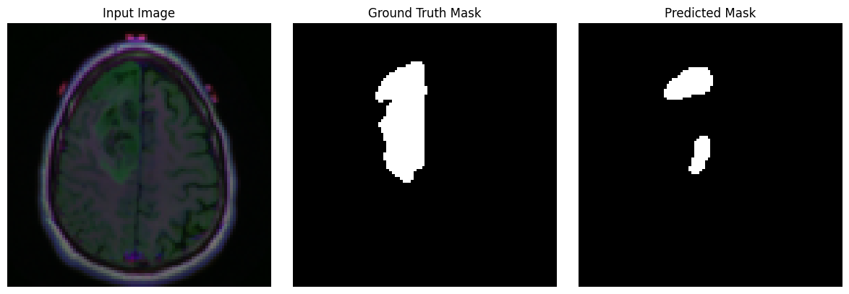
U-Net with 0.7 CE Combo Loss visualizing the training region evolution

Slide 51
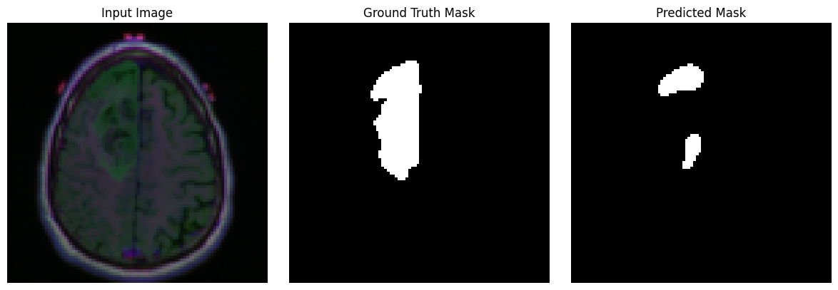
U-Net with 0.7 CE Combo Loss visualizing the training region evolution

Slide 52
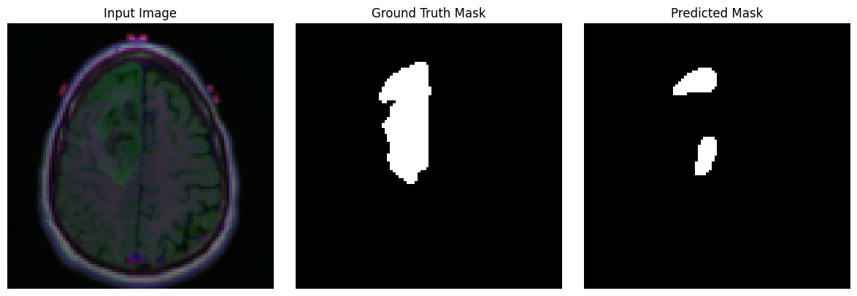
U-Net with 0.7 CE Combo Loss visualizing the training region evolution

Slide 53
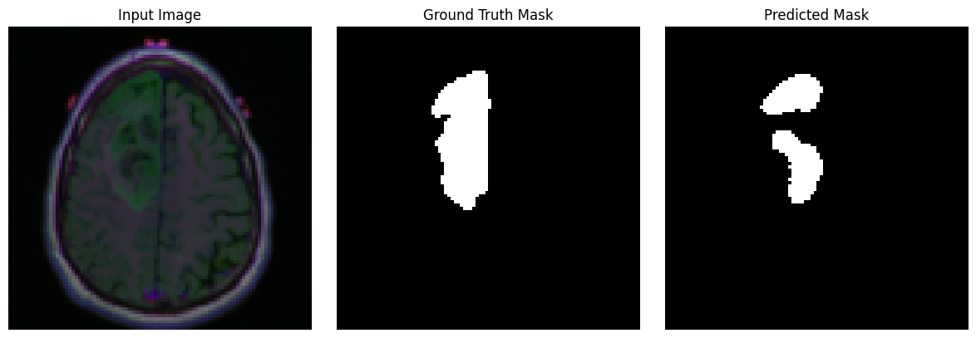
U-Net with 0.7 CE Combo Loss visualizing the training region evolution

Slide 54
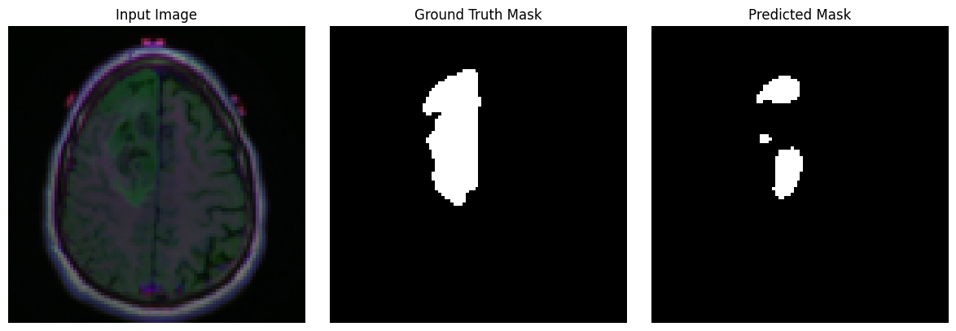
U-Net with 0.7 CE Combo Loss visualizing the training region evolution

Slide 55
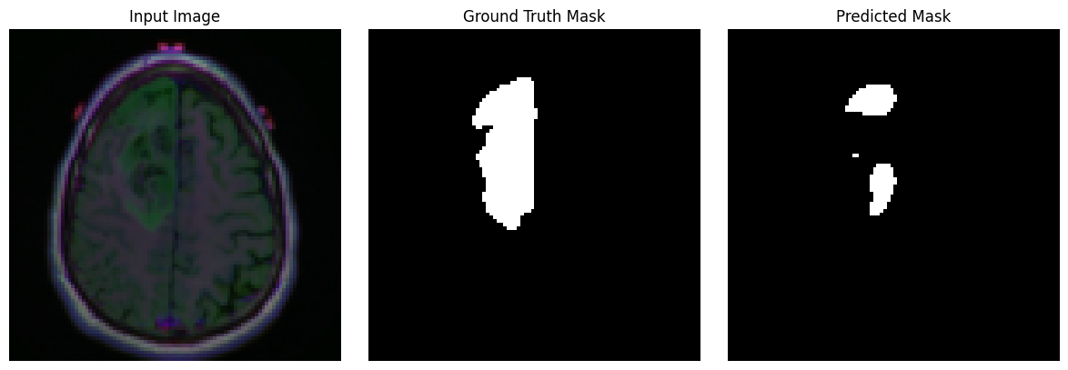
U-Net with 0.7 CE Combo Loss visualizing the training region evolution

Slide 56

U-Net with 0.7 CE Combo Loss visualizing the training region evolution

Slide 57
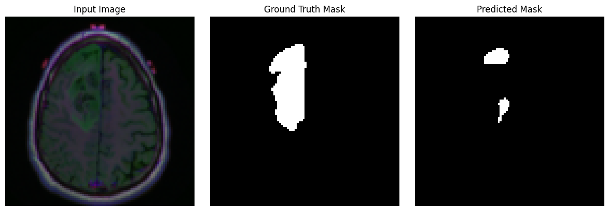
U-Net with 0.7 CE Combo Loss visualizing the training region evolution

Slide 58
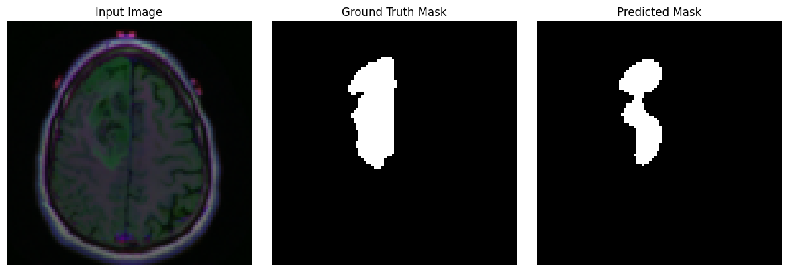
U-Net with 0.7 CE Combo Loss visualizing the training region evolution

Slide 59
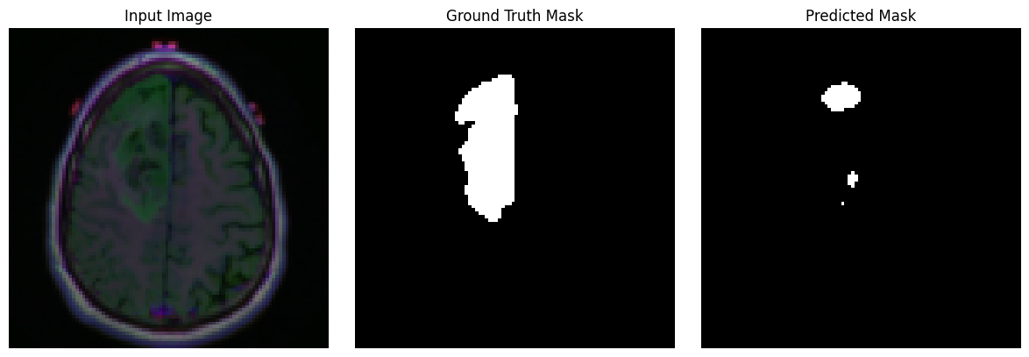
U-Net with 0.7 CE Combo Loss visualizing the training region evolution

Slide 60
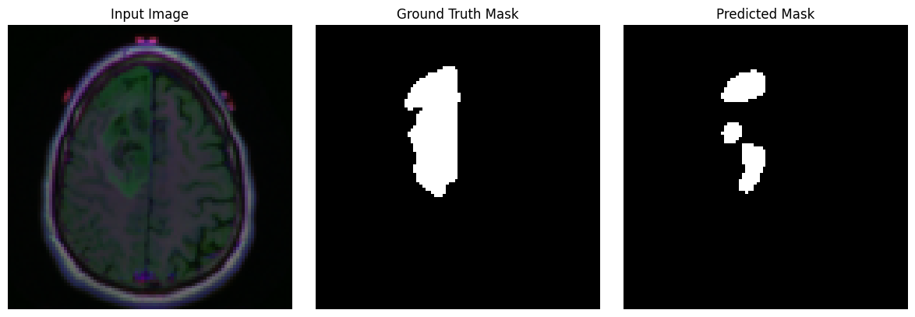
U-Net with 0.7 CE Combo Loss visualizing the training region evolution

Slide 61
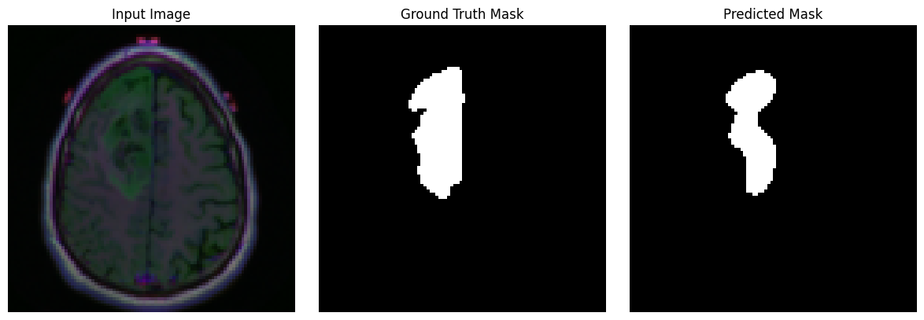
U-Net with 0.7 CE Combo Loss visualizing the training region evolution

Slide 62
U-Net with 0.7 CE Combo Loss visualizing the training region evolution

Slide 63
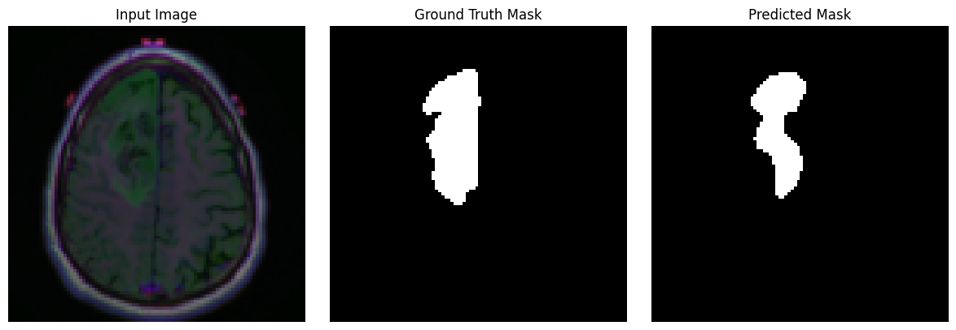
U-Net with 0.7 CE Combo Loss visualizing the training region evolution

Slide 64
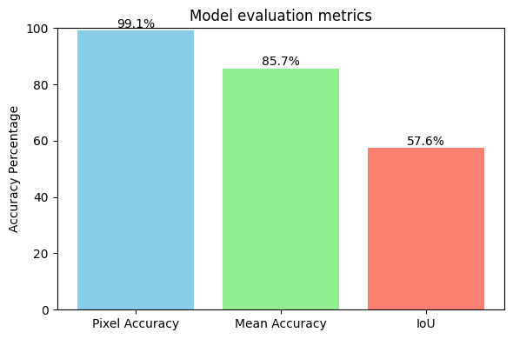

U-Net with 0.7 CE Combo Loss Accuracy results on the test set
And with epochs increase…
Notes:
IoU intersection over union

Slide 65
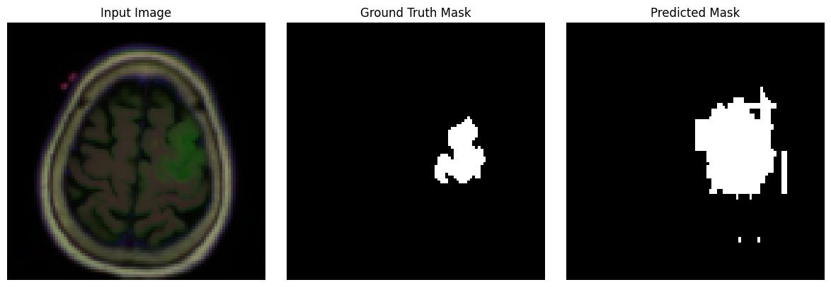
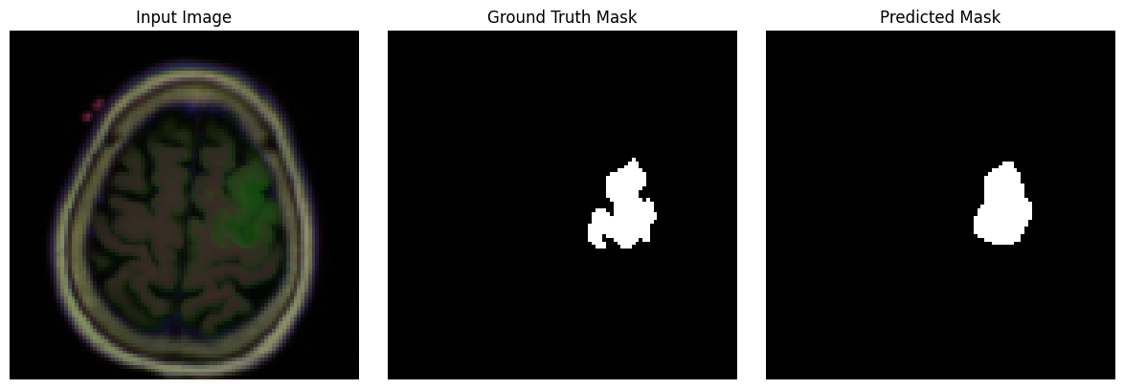
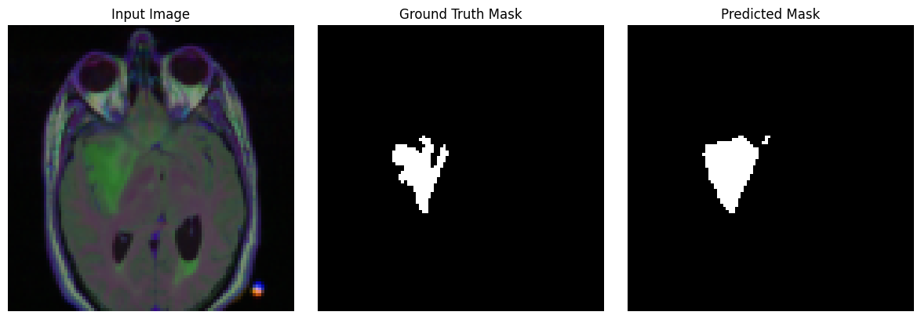
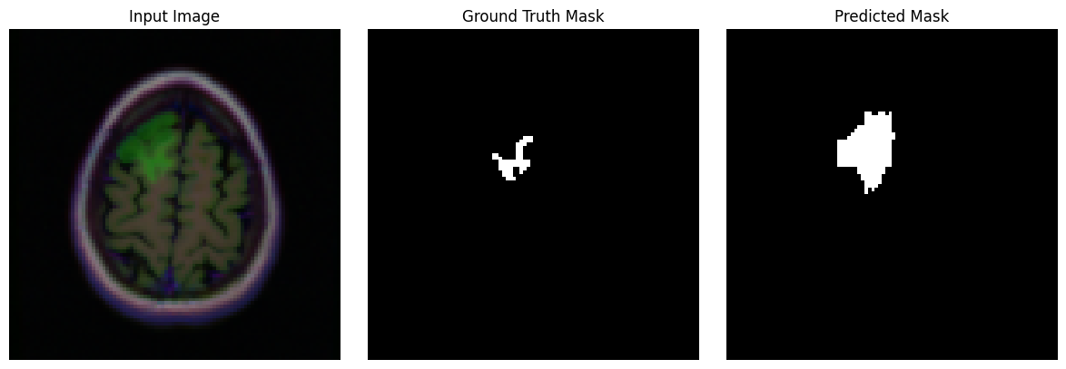
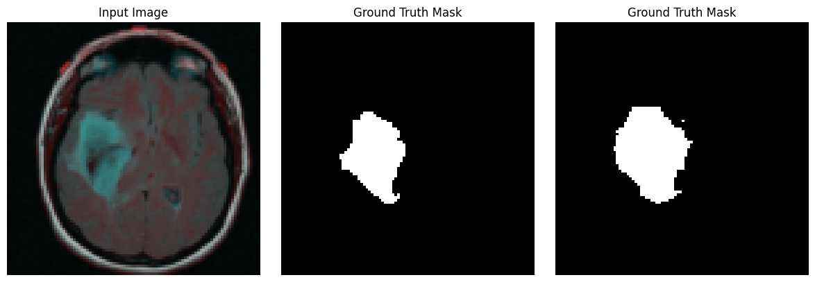

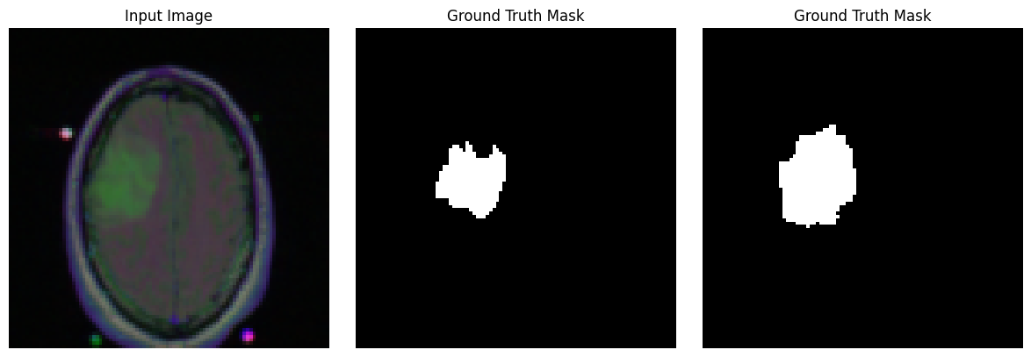
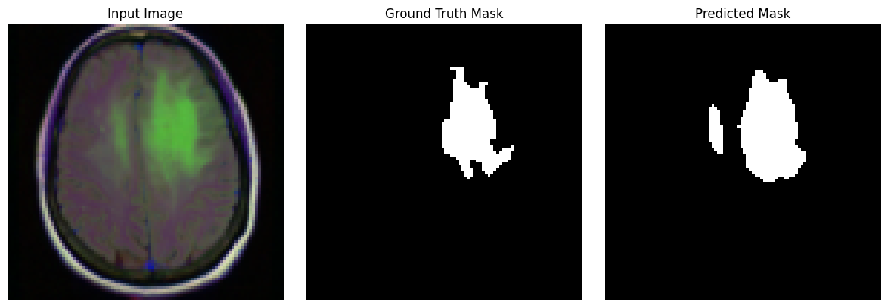












U-Net with 0.7 CE-R Combo Loss : What about other samples?

Slide 66

U-Net with 0.5 CE Combo Loss Training Informations
Adam optimizer with ${10}^{−4}$ learning rate
$∼40$ training epochs
Saved an image and mask prediction, so to make available the training region evolution visualization…

Slide 67

U-Net with 0.5 CE-R Combo Loss visualizing the training region evolution

Slide 68

U-Net with 0.5 CE-R Combo Loss visualizing the training region evolution

Slide 69

U-Net with 0.5 CE-R Combo Loss visualizing the training region evolution

Slide 70

U-Net with 0.5 CE-R Combo Loss visualizing the training region evolution

Slide 71

U-Net with 0.5 CE-R Combo Loss visualizing the training region evolution

Slide 72

U-Net with 0.5 CE-R Combo Loss visualizing the training region evolution

Slide 73

U-Net with 0.5 CE-R Combo Loss visualizing the training region evolution

Slide 74

U-Net with 0.5 CE-R Combo Loss visualizing the training region evolution

Slide 75

U-Net with 0.5 CE-R Combo Loss visualizing the training region evolution

Slide 76

U-Net with 0.5 CE-R Combo Loss visualizing the training region evolution

Slide 77

U-Net with 0.5 CE-R Combo Loss visualizing the training region evolution

Slide 78
U-Net with Combo Loss Model Comparison
Combo ratio 0.7
Approx 20 epochs learning
Combo ratio 0.5
Approx 40 epochs learning
Notes:
IoU intersection over union

Slide 79






U-Net with 0.7 CE-R Combo Loss : What about other samples?

Slide 80
Vision Transformers
U-net is not the only approach we can try for this specific task, since the recent advances with vision transformed has shown great results [9]
The idea is to offer a similar approach to image handling than the one proposed to the Natural Language processing word one.
Transformers as architectures are originally designed for sequential data in Natural Language Processing and those are based on the self-attention mechanism; the visual transformer leverage the same architecture for the image handling.
ViTs divide the image into patches and process each of them as token element of the sequence,
The key differences are patches usage, attention and positional embedding for spacial information
Notes:
same as words in a sentence. By using self attention, the ViTs are able to introduce attentions between all image patches, making implicitly and without convolution available the local and global dependency treated.

Slide 81

Vision Transformers: SETR
Fig 4. Schematic illustration of the proposed SEgmentation TRansformer (SETR). []
Notes:
> **Fig 4.** Schematic illustration of the proposed SEgmentation TRansformer (SETR) (a). We first split an image into fixed-size patches, linearly embed each of them, add position embeddings, and feed the resulting sequence of vectors to a standard Transformer encoder. To perform pixel-wise segmentation, we introduce different decoder designs: (b) progressive upsampling (resulting in a variant called SETRPUP); and (c) multi-level feature aggregation (a variant called SETR-MLA).

Slide 82
class SETR(nn.Module):
def __init__(self, img_size=128, num_cuts = 4,in_ch=3, num_classes=1, dim=1024, depth=8, heads=8, mlp_dim=2048):
super().__init__()
# Internal parameters definition:
self.patch_size = int(W / num_cuts)
self.num_cuts = num_cuts
self.num_patches = self.num_cuts ** 2
self.dim = dim
self.in_ch = in_ch
# Patch + Positional Embedding. We need to redefine this due to generalization...
self.patch_embed = nn.Linear(self.patch_size * self.patch_size * in_ch, dim)
self.pos_embed = nn.Parameter(torch.randn(1, self.num_patches, dim))
# Transformer Encoder. We refer to the previously defined class
self.transformer = nn.Sequential(
*[TransformerEncoderLayer(dim, heads, mlp_dim) for _ in range(depth)]
)
# Deconvolution decoder
# Notice that is the same of before byt dimension here is generic
self.decoder = nn.Sequential(
nn.ConvTranspose2d(dim, 256, kernel_size=2, stride=2), nn.ReLU(),
nn.ConvTranspose2d(256, 256, kernel_size=2, stride=2), nn.ReLU(),
nn.ConvTranspose2d(256, 256, kernel_size=2, stride=2), nn.ReLU(),
nn.ConvTranspose2d(256, 256, kernel_size=2, stride=2), nn.ReLU(),
nn.Conv2d(256, num_classes, kernel_size=1))
def forward(self, x):
# Split image into patches
B = x.size(0)
x = x.unfold(2, self.patch_size, self.patch_size)\
.unfold(3, self.patch_size, self.patch_size)\
.permute(0, 2, 3, 1, 4, 5)\
.reshape(B, self.num_patches, self.in_ch * self.patch_size * self.patch_size)
# Embedding + Positional encoding
x = self.patch_embed(x) + self.pos_embed
# Transformer encoder
x = x.permute(1, 0, 2) # (N, B, dim) for nn.MultiheadAttention
x = self.transformer(x)
x = x.permute(1, 2, 0) # (B, dim, N)
# Reshape to 2D feature map
x = x.reshape(B, self.dim, self.num_cuts, self.num_cuts) # (B, dim, H/16, W/16)
# Decoder
x = self.decoder(x) # (B, num_classes, H, W)
# Now we need values at zero or one
return torch.sigmoid(x)

Slide 83
class SETR(nn.Module):
def __init__(self, img_size=128, num_cuts = 4,in_ch=3, num_classes=1, dim=1024, depth=8, heads=8, mlp_dim=2048):
super().__init__()
# Internal parameters definition:
self.patch_size = int(W / num_cuts)
self.num_cuts = num_cuts
self.num_patches = self.num_cuts ** 2
self.dim = dim
self.in_ch = in_ch
# Patch + Positional Embedding. We need to redefine this due to generalization...
self.patch_embed = nn.Linear(self.patch_size * self.patch_size * in_ch, dim)
self.pos_embed = nn.Parameter(torch.randn(1, self.num_patches, dim))
# Transformer Encoder. We refer to the previously defined class
self.transformer = nn.Sequential(
*[TransformerEncoderLayer(dim, heads, mlp_dim) for _ in range(depth)]
)
# Deconvolution decoder
# Notice that is the same of before byt dimension here is generic
self.decoder = nn.Sequential(
nn.ConvTranspose2d(dim, 256, kernel_size=2, stride=2), nn.ReLU(),
nn.ConvTranspose2d(256, 256, kernel_size=2, stride=2), nn.ReLU(),
nn.ConvTranspose2d(256, 256, kernel_size=2, stride=2), nn.ReLU(),
nn.ConvTranspose2d(256, 256, kernel_size=2, stride=2), nn.ReLU(),
nn.Conv2d(256, num_classes, kernel_size=1))
Forward of the model
def forward(self, x):
# Split image into patches
B = x.size(0)
x = x.unfold(2, self.patch_size, self.patch_size)\
.unfold(3, self.patch_size, self.patch_size)\
.permute(0, 2, 3, 1, 4, 5)\
.reshape(B, self.num_patches, self.in_ch * self.patch_size * self.patch_size)
# Embedding + Positional encoding
x = self.patch_embed(x) + self.pos_embed
# Transformer encoder
x = x.permute(1, 0, 2) # (N, B, dim) for nn.MultiheadAttention
x = self.transformer(x)
x = x.permute(1, 2, 0) # (B, dim, N)
# Reshape to 2D feature map
x = x.reshape(B, self.dim, self.num_cuts, self.num_cuts) # (B, dim, H/16, W/16)
# Decoder
x = self.decoder(x) # (B, num_classes, H, W)
# Now we need values at zero or one
return torch.sigmoid(x)

Slide 84
class SETR(nn.Module):
def __init__(self, img_size=128, num_cuts = 4,in_ch=3, num_classes=1, dim=1024, depth=8, heads=8, mlp_dim=2048):
super().__init__()
# Internal parameters definition:
self.patch_size = int(W / num_cuts)
self.num_cuts = num_cuts
self.num_patches = self.num_cuts ** 2
self.dim = dim
self.in_ch = in_ch
# Patch + Positional Embedding. We need to redefine this due to generalization...
self.patch_embed = nn.Linear(self.patch_size * self.patch_size * in_ch, dim)
self.pos_embed = nn.Parameter(torch.randn(1, self.num_patches, dim))
# Transformer Encoder. We refer to the previously defined class
self.transformer = nn.Sequential(
*[TransformerEncoderLayer(dim, heads, mlp_dim) for _ in range(depth)]
)
# Deconvolution decoder
# Notice that is the same of before byt dimension here is generic
self.decoder = nn.Sequential(
nn.ConvTranspose2d(dim, 256, kernel_size=2, stride=2), nn.ReLU(),
nn.ConvTranspose2d(256, 256, kernel_size=2, stride=2), nn.ReLU(),
nn.ConvTranspose2d(256, 256, kernel_size=2, stride=2), nn.ReLU(),
nn.ConvTranspose2d(256, 256, kernel_size=2, stride=2), nn.ReLU(),
nn.Conv2d(256, num_classes, kernel_size=1))
def forward(self, x):
# Split image into patches
B = x.size(0)
x = x.unfold(2, self.patch_size, self.patch_size)\
.unfold(3, self.patch_size, self.patch_size)\
.permute(0, 2, 3, 1, 4, 5)\
.reshape(B, self.num_patches, self.in_ch * self.patch_size * self.patch_size)
# Embedding + Positional encoding
x = self.patch_embed(x) + self.pos_embed
# Transformer encoder
x = x.permute(1, 0, 2) # (N, B, dim) for nn.MultiheadAttention
x = self.transformer(x)
x = x.permute(1, 2, 0) # (B, dim, N)
# Reshape to 2D feature map
x = x.reshape(B, self.dim, self.num_cuts, self.num_cuts) # (B, dim, H/16, W/16)
# Decoder
x = self.decoder(x) # (B, num_classes, H, W)
# Now we need values at zero or one
return torch.sigmoid(x)

Slide 85

# Split image into patches
B = x.size(0)
x = x.unfold(2, self.patch_size, self.patch_size)\
.unfold(3, self.patch_size, self.patch_size)\
.permute(0, 2, 3, 1, 4, 5)\
.reshape(B, self.num_patches, self.in_ch * self.patch_size * self.patch_size)

Slide 86
2 is the height dimension
Patch cutting size
# Split image into patches
B = x.size(0)
x = x.unfold(2, self.patch_size, self.patch_size)\
.unfold(3, self.patch_size, self.patch_size)\
.permute(0, 2, 3, 1, 4, 5)\
.reshape(B, self.num_patches, self.in_ch * self.patch_size * self.patch_size)
As if the slices are in a collector tensor itself
Now we have something like $[B, 3, p.num H, p. num W , p. size H, p. size W]$

Slide 87
Now we have something like $[B, 3, p.num H, p. num W , p. size H, p. size W]$
# Split image into patches
B = x.size(0)
x = x.unfold(2, self.patch_size, self.patch_size)\
.unfold(3, self.patch_size, self.patch_size)\
.permute(0, 2, 3, 1, 4, 5)\
.reshape(B, self.num_patches, self.in_ch * self.patch_size * self.patch_size)
So we need to reorganize in $[B, p.num H, p. num W,3, p. size H, p. size W]$
Each image patch is now a 1D vector
The number of patches should be elevated, even if this is a time-consuming obligation

Slide 88
def forward(self, x):
# Split image into patches
B = x.size(0)
x = x.unfold(2, self.patch_size, self.patch_size)\
.unfold(3, self.patch_size, self.patch_size)\
.permute(0, 2, 3, 1, 4, 5)\
.reshape(B, self.num_patches, self.in_ch * self.patch_size * self.patch_size)
# Embedding + Positional encoding
x = self.patch_embed(x) + self.pos_embed
# Transformer encoder
x = x.permute(1, 0, 2) # (N, B, dim) for nn.MultiheadAttention
x = self.transformer(x)
x = x.permute(1, 2, 0) # (B, dim, N)
# Reshape to 2D feature map
x = x.reshape(B, self.dim, self.num_cuts, self.num_cuts) # (B, dim, H/16, W/16)
# Decoder
x = self.decoder(x) # (B, num_classes, H, W)
# Now we need values at zero or one
return torch.sigmoid(x)

Slide 89
# Embedding + Positional encoding
x = self.patch_embed(x) + self.pos_embed
with
self.patch_embed = nn.Linear(self.patch_size * self.patch_size * in_ch, dim)
self.pos_embed = nn.Parameter(torch.randn(1, self.num_patches, dim))
After each patch transformation in a 1D vector
we transform it into a proper token of chosen dimension dim

Slide 90
def forward(self, x):
# Split image into patches
B = x.size(0)
x = x.unfold(2, self.patch_size, self.patch_size)\
.unfold(3, self.patch_size, self.patch_size)\
.permute(0, 2, 3, 1, 4, 5)\
.reshape(B, self.num_patches, self.in_ch * self.patch_size * self.patch_size)
# Embedding + Positional encoding
x = self.patch_embed(x) + self.pos_embed
# Transformer encoder
x = x.permute(1, 0, 2) # (N, B, dim) for nn.MultiheadAttention
x = self.transformer(x)
x = x.permute(1, 2, 0) # (B, dim, N)
# Reshape to 2D feature map
x = x.reshape(B, self.dim, self.num_cuts, self.num_cuts) # (B, dim, H/16, W/16)
# Decoder
x = self.decoder(x) # (B, num_classes, H, W)
# Now we need values at zero or one
return torch.sigmoid(x)

Slide 91
# Transformer encoder
x = x.permute(1, 0, 2) # (N, B, dim) for nn.MultiheadAttention
x = self.transformer(x)
x = x.permute(1, 2, 0) # (B, dim, N)
class TransformerEncoderLayer(nn.Module):
def __init__(self, dim, heads, mlp_dim):
super().__init__()
self.norm1 = nn.LayerNorm(dim)
self.attn = nn.MultiheadAttention(embed_dim=dim, num_heads=heads)
self.norm2 = nn.LayerNorm(dim)
self.mlp = nn.Sequential(
nn.Linear(dim, mlp_dim),
nn.ReLU(),
nn.Linear(mlp_dim, dim)
)
def forward(self, x):
x = x + self.attn(self.norm1(x), self.norm1(x), self.norm1(x))[0]
x = x + self.mlp(self.norm2(x))
return x
self.transformer = nn.Sequential(
*[TransformerEncoderLayer(dim, heads, mlp_dim) for i in range(depth)]
)
«depth» times transformer layer applied in sequence

Slide 92
def forward(self, x):
# Split image into patches
B = x.size(0)
x = x.unfold(2, self.patch_size, self.patch_size)\
.unfold(3, self.patch_size, self.patch_size)\
.permute(0, 2, 3, 1, 4, 5)\
.reshape(B, self.num_patches, self.in_ch * self.patch_size * self.patch_size)
# Embedding + Positional encoding
x = self.patch_embed(x) + self.pos_embed
# Transformer encoder
x = x.permute(1, 0, 2) # (N, B, dim) for nn.MultiheadAttention
x = self.transformer(x)
x = x.permute(1, 2, 0) # (B, dim, N)
# Reshape to 2D feature map
x = x.reshape(B, self.dim, self.num_cuts, self.num_cuts) # (B, dim, H/16, W/16)
# Decoder
x = self.decoder(x) # (B, num_classes, H, W)
# Now we need values at zero or one
return torch.sigmoid(x)

Slide 93
# Decoder
x = self.decoder(x) # (B, num_classes, H, W)
# Now we need values at zero or one
return torch.sigmoid(x)
decoder = nn.Sequential(
nn.ConvTranspose2d(dim, 256, kernel_size=2, stride=2), nn.ReLU(),
nn.ConvTranspose2d(256, 256, kernel_size=2, stride=2), nn.ReLU(),
nn.ConvTranspose2d(256, 256, kernel_size=2, stride=2), nn.ReLU(),
nn.ConvTranspose2d(256, 256, kernel_size=2, stride=2), nn.ReLU(),
nn.Conv2d(256, 1, kernel_size=1))

Slide 94
class SETR(nn.Module):
def __init__(self, img_size=128, num_cuts = 4,in_ch=3, num_classes=1, dim=1024, depth=8, heads=8, mlp_dim=2048):
super().__init__()
# Internal parameters definition:
self.patch_size = int(W / num_cuts)
self.num_cuts = num_cuts
self.num_patches = self.num_cuts ** 2
self.dim = dim
self.in_ch = in_ch
# Patch + Positional Embedding. We need to redefine this due to generalization...
self.patch_embed = nn.Linear(self.patch_size * self.patch_size * in_ch, dim)
self.pos_embed = nn.Parameter(torch.randn(1, self.num_patches, dim))
# Transformer Encoder. We refer to the previously defined class
self.transformer = nn.Sequential(
*[TransformerEncoderLayer(dim, heads, mlp_dim) for _ in range(depth)]
)
# Deconvolution decoder
# Notice that is the same of before byt dimension here is generic
self.decoder = nn.Sequential(
nn.ConvTranspose2d(dim, 256, kernel_size=2, stride=2), nn.ReLU(),
nn.ConvTranspose2d(256, 256, kernel_size=2, stride=2), nn.ReLU(),
nn.ConvTranspose2d(256, 256, kernel_size=2, stride=2), nn.ReLU(),
nn.ConvTranspose2d(256, 256, kernel_size=2, stride=2), nn.ReLU(),
nn.Conv2d(256, num_classes, kernel_size=1))
def forward(self, x):
# Split image into patches
B = x.size(0)
x = x.unfold(2, self.patch_size, self.patch_size)\
.unfold(3, self.patch_size, self.patch_size)\
.permute(0, 2, 3, 1, 4, 5)\
.reshape(B, self.num_patches, self.in_ch * self.patch_size * self.patch_size)
# Embedding + Positional encoding
x = self.patch_embed(x) + self.pos_embed
# Transformer encoder
x = x.permute(1, 0, 2) # (N, B, dim) for nn.MultiheadAttention
x = self.transformer(x)
x = x.permute(1, 2, 0) # (B, dim, N)
# Reshape to 2D feature map
x = x.reshape(B, self.dim, self.num_cuts, self.num_cuts) # (B, dim, H/16, W/16)
# Decoder
x = self.decoder(x) # (B, num_classes, H, W)
# Now we need values at zero or one
return torch.sigmoid(x)

Slide 95
def forward(self, x):
# Split image into patches
B = x.size(0)
x = x.unfold(2, self.patch_size, self.patch_size)\
.unfold(3, self.patch_size, self.patch_size)\
.permute(0, 2, 3, 1, 4, 5)\
.reshape(B, self.num_patches, self.in_ch * self.patch_size * self.patch_size)
# Embedding + Positional encoding
x = self.patch_embed(x) + self.pos_embed
# Transformer encoder
x = x.permute(1, 0, 2) # (N, B, dim) for nn.MultiheadAttention
x = self.transformer(x)
x = x.permute(1, 2, 0) # (B, dim, N)
# Reshape to 2D feature map
x = x.reshape(B, self.dim, self.num_cuts, self.num_cuts) # (B, dim, H/16, W/16)
# Decoder
x = self.decoder(x) # (B, num_classes, H, W)
# Now we need values at zero or one
return torch.sigmoid(x)

Slide 96

SETR with Dice Loss Training Informations
Adam optimizer with ${10}^{−4}$ learning rate
$∼350$ training epochs
Saved an image and mask prediction, so to make available the training region evolution visualization…

Slide 97

SETR with Dice Loss Visualizing the training region evolution
Epoche: 10 + 8 + 20

Slide 98

SETR with Dice Loss Visualizing the training region evolution

Slide 99

SETR with Dice Loss Visualizing the training region evolution

Slide 100

SETR with Dice Loss Visualizing the training region evolution

Slide 101

SETR with Dice Loss Visualizing the training region evolution

Slide 102

SETR with Dice Loss Visualizing the training region evolution

Slide 103

SETR with Dice Loss Visualizing the training region evolution

Slide 104

SETR with Dice Loss Visualizing the training region evolution

Slide 105

SETR with Dice Loss Visualizing the training region evolution

Slide 106

SETR with Dice Loss Visualizing the training region evolution

Slide 107

SETR with Dice Loss Visualizing the training region evolution

Slide 108

SETR with Dice Loss Visualizing the training region evolution

Slide 109

SETR with Dice Loss Visualizing the training region evolution

Slide 110

SETR with Dice Loss Visualizing the training region evolution

Slide 111

SETR with Dice Loss Visualizing the training region evolution

Slide 112

SETR with Dice Loss Visualizing the training region evolution

Slide 113

SETR with Dice Loss Visualizing the training region evolution

Slide 114

SETR with Dice Loss Visualizing the training region evolution

Slide 115

SETR with Dice Loss Visualizing the training region evolution

Slide 116

SETR with Dice Loss Visualizing the training region evolution

Slide 117
SETR with Dice Loss Visualizing the training region evolution
But after 300 learning epochs, i.e. $∼$6 training hours

Slide 118

SETR with Dice Loss Visualizing the training region evolution

Slide 119

SETR with Dice Loss Visualizing the training region evolution

Slide 120

SETR with Dice Loss Visualizing the training region evolution

Slide 121

SETR with Dice Loss Visualizing the training region evolution

Slide 122

SETR with Dice Loss Visualizing the training region evolution

Slide 123

SETR with Dice Loss Visualizing the training region evolution

Slide 124

SETR with Dice Loss Visualizing the training region evolution

Slide 125

SETR with Dice Loss Visualizing the training region evolution

Slide 126

SETR with Dice Loss Visualizing the training region evolution

Slide 127

SETR with Dice Loss Visualizing the training region evolution

Slide 128

SETR with Dice Loss Visualizing the training region evolution

Slide 129

SETR with Dice Loss Visualizing the training region evolution

Slide 130

SETR with Dice Loss Visualizing the training region evolution

Slide 131

SETR with Dice Loss Visualizing the training region evolution

Slide 132

SETR with Dice Loss Visualizing the training region evolution

Slide 133

SETR with Dice Loss Visualizing the training region evolution

Slide 134

SETR with Dice Loss Visualizing the training region evolution

Slide 135

SETR with Dice Loss Visualizing the training region evolution

Slide 136

SETR with Dice Loss Visualizing the training region evolution

Slide 137

SETR with Dice Loss Visualizing the training region evolution

Slide 138

SETR with Dice Loss Visualizing the training region evolution

Slide 139

SETR with Dice Loss Visualizing the training region evolution

Slide 140

SETR with Dice Loss Visualizing the training region evolution

Slide 141
SETR with Dice Loss : What about other samples?

Slide 142


Final model comparison
Combo ratio 0.7
Approx 20 epochs learning
Combo ratio 0.5
Approx 40 epochs learning
SETR Dice
Approx 350 epochs learning
Notes:
IoU intersection over union

Slide 143

Conclusions
We saw different approaches for the segmentation task for FLAIR brain tumors, with a focus on loss choices and model precision evolution.
Better results could be achieved with higher image resolution and training epochs, together with higher computational power: proposed U-net models have approximatively 1 million of parameters, while the transformer one approximatively 30% more.

Slide 144

Conclusions
But if we used a right-dimensional transformer, with
num_cuts=24,
dim=1024,
depth=24,
heads=8,
mlp_dim=2048
It’d have had 200 million parameters.
No personal computer could have trained it.

Slide 145

Conclusions
Finally, we can recover from the formal definition that each predicted mask is a matrix of probabilities: we can access the model certainty around the prediction…
$$with M=M_{NxNx1}\left([0,1]\right), m_{i,j}∼p(M_{i,j}=tumoral)$$
…that we can visualize it as an image overlay.

Slide 146


Probability Mask overlay SETR model

Slide 147


Probability Mask overlay Dice U-Net model

Slide 148


Probability Mask overlay Combo 0.7 U-Net model

Slide 149


Probability Mask overlay Combo 0.5 U-Net model

Slide 150
Project References
[1] EU cancer statistics: https://ec.europa.eu/eurostat/statistics-explained/index.php?title=Cancer_statistics
[2] Brain tumor segmentation with Deep Neural Networks,Medical Image Analysis, Mohammad Havaei, Axel Davy, and others. https://doi.org/10.1016/j.media.2016.05.004.
[3] Multi-class glioma segmentation on real-world data with missing MRI sequences: comparison of three deep learning algorithms: https://www.nature.com/articles/s41598-023-44794-0
[4] Dataset: https://www.kaggle.com/datasets/mateuszbuda/lgg-mri-segmentation
[5] Azad, R., Heidary, M., Yilmaz, K., Hüttemann, M., Karimijafarbigloo, S., Wu, Y., Schmeink, A., & Merhof, D. (2023). Loss Functions in the Era of Semantic Segmentation: A Survey and Outlook. arXiv:2312.05391. https://arxiv.org/abs/2312.05391
[6] Ronneberger, O., Fischer, P., & Brox, T. (2015). U-Net: Convolutional Networks for Biomedical Image Segmentation. arXiv preprint arXiv:1505.04597. https://arxiv.org/abs/1505.04597
[7] The U-net: A Complete Guide. https://medium.com/@alejandro.itoaramendia/decoding-the-u-net-a-complete-guide-810b1c6d56d8
[8] Loss Function library: https://www.kaggle.com/code/bigironsphere/loss-function-library-keras-pytorch#Combo-Loss
[9] Image Segmentation Using Vision Transformers (ViT): A Deep Dive with Cityscapes and CamVid Datasets https://medium.com/@ankitrajsh/image-segmentation-using-vision-transformers-vit-a-deep-dive-with-cityscapes-and-camvid-datasets-fc1ccdca295b
[10] Segmenter: Transformer for Semantic Segmentation, Robin Strudel and Ricardo Garcia and Ivan Laptev and Cordelia Schmid, https://arxiv.org/abs/2105.05633

